Slide 1
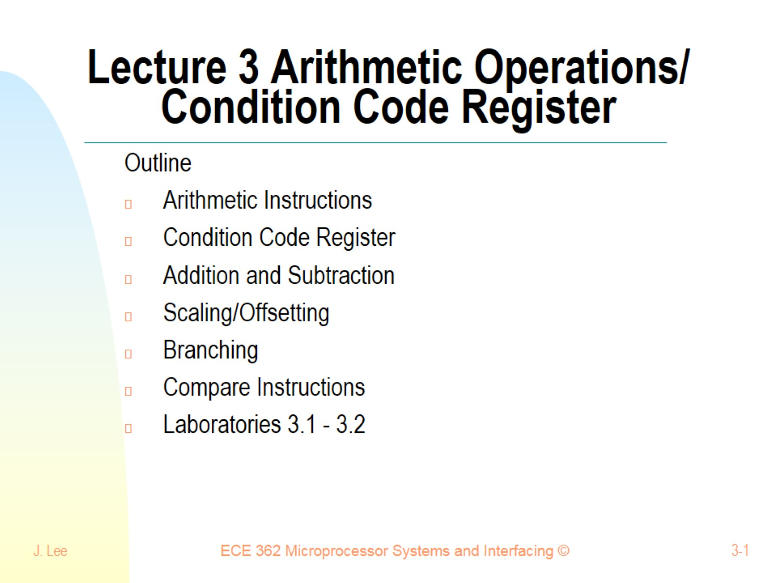
Lecture 3 Arithmetic Operations/ Condition Code Register

Slide 2
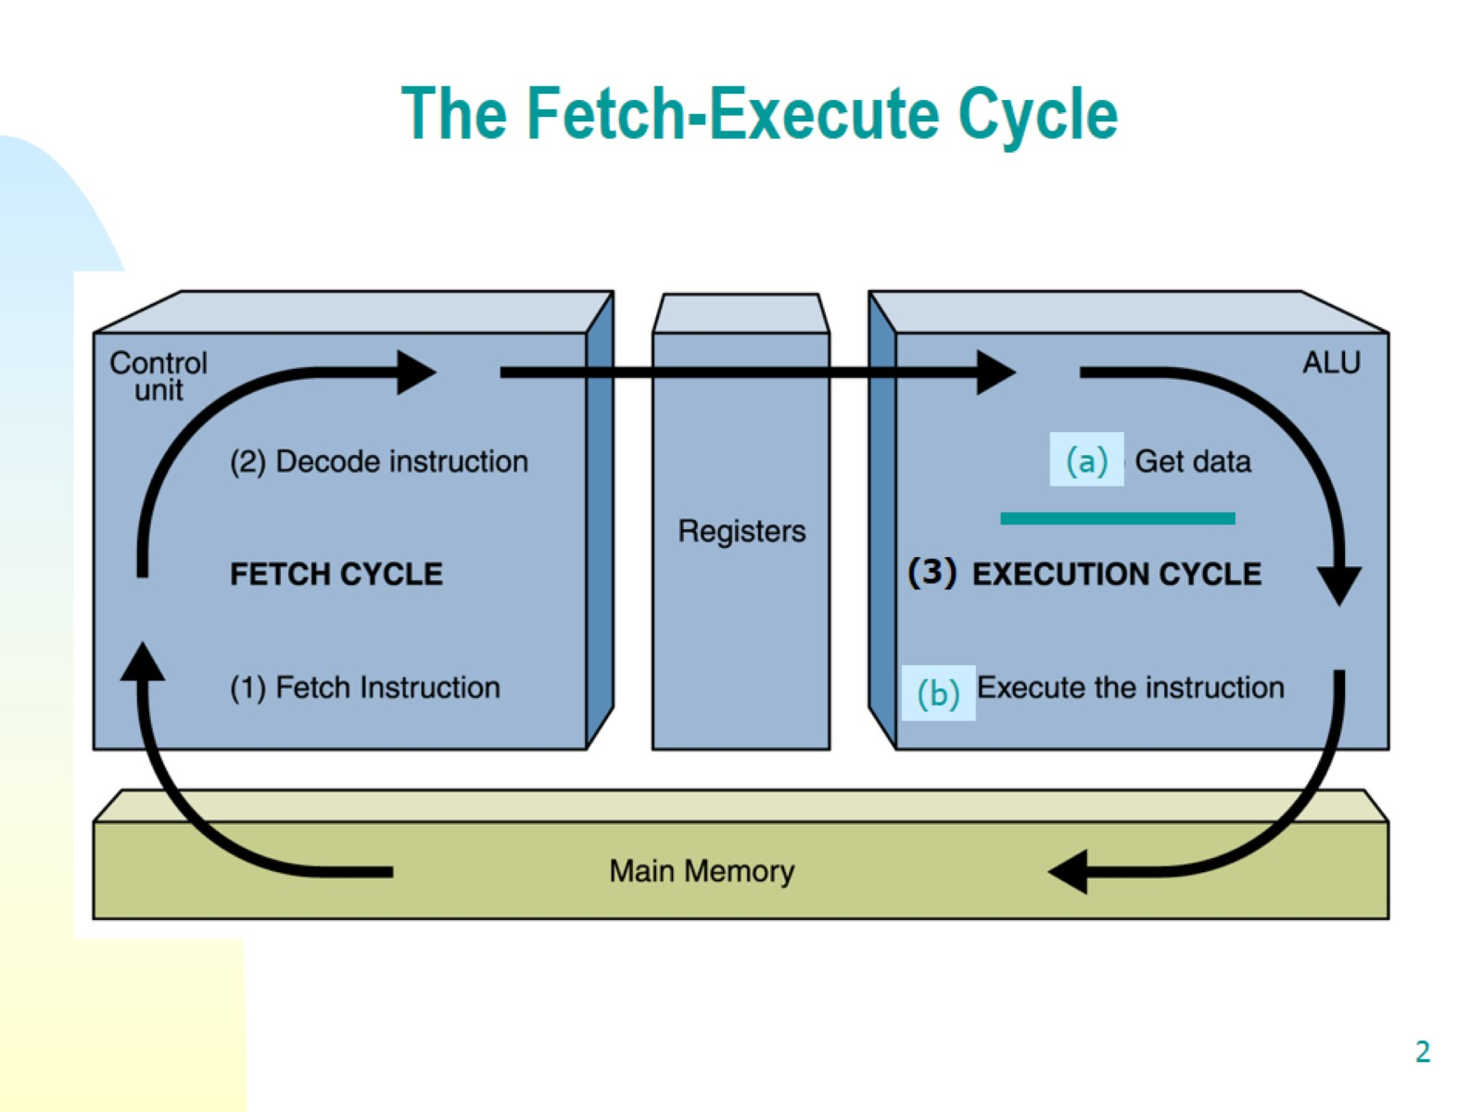
The Fetch-Execute Cycle

Slide 3
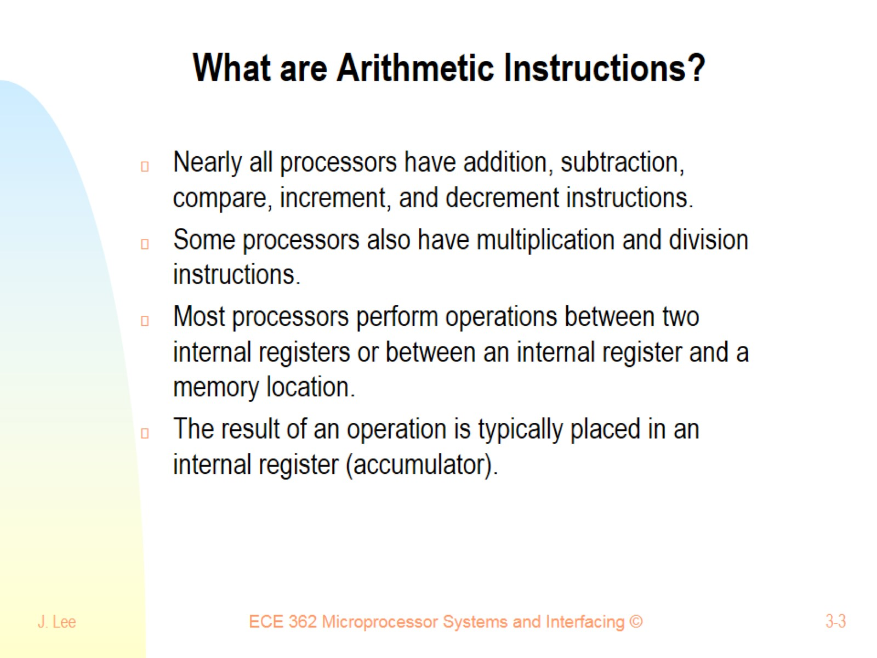
What are Arithmetic Instructions?

Slide 4
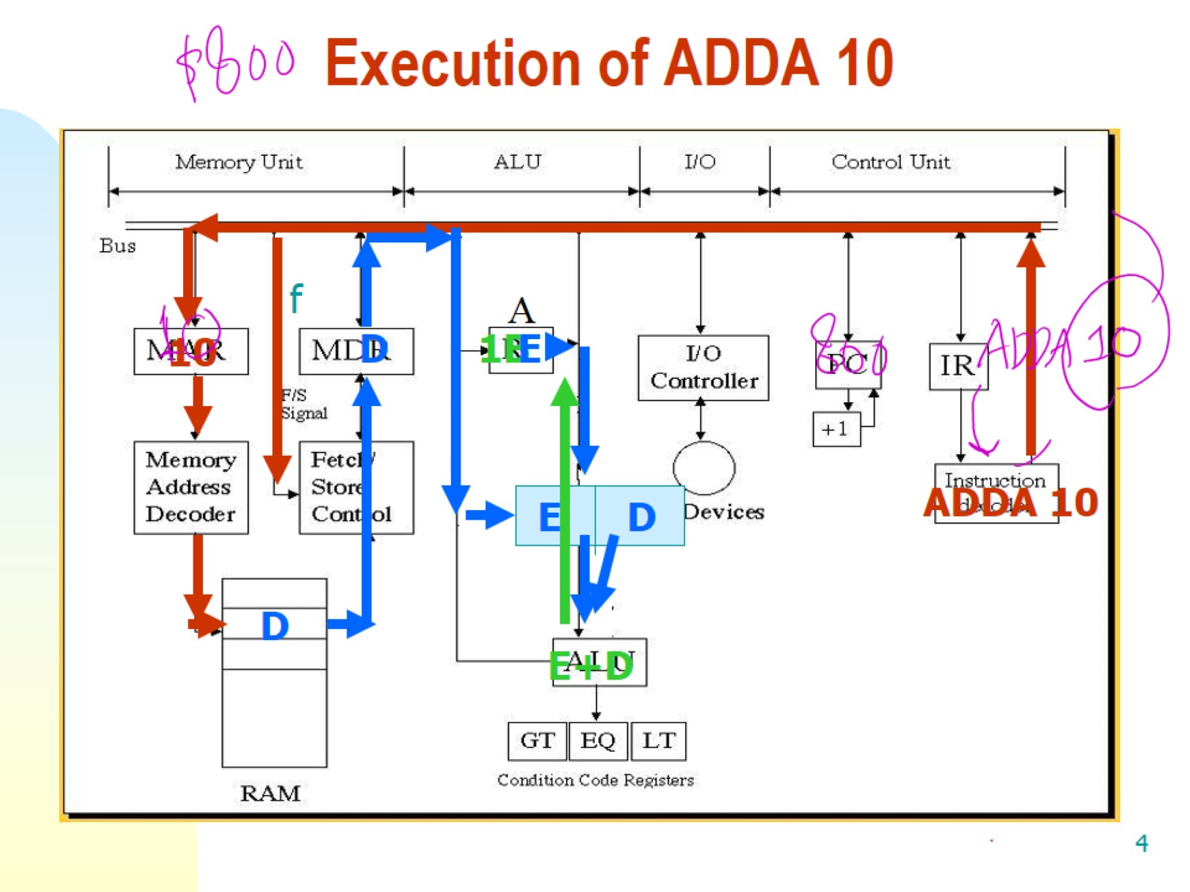
Execution of ADDA 10

Slide 5
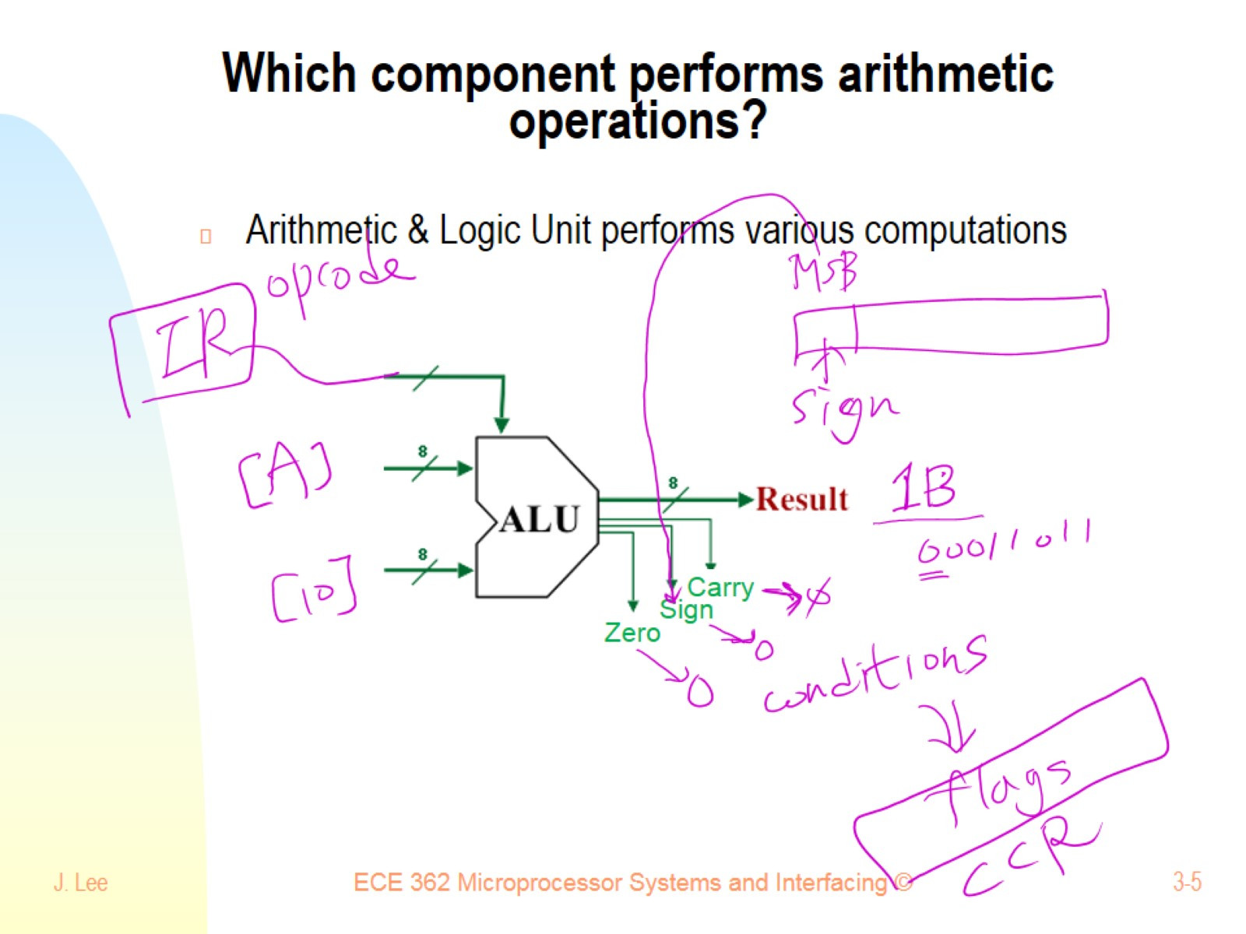
Which component performs arithmetic operations?

Slide 6
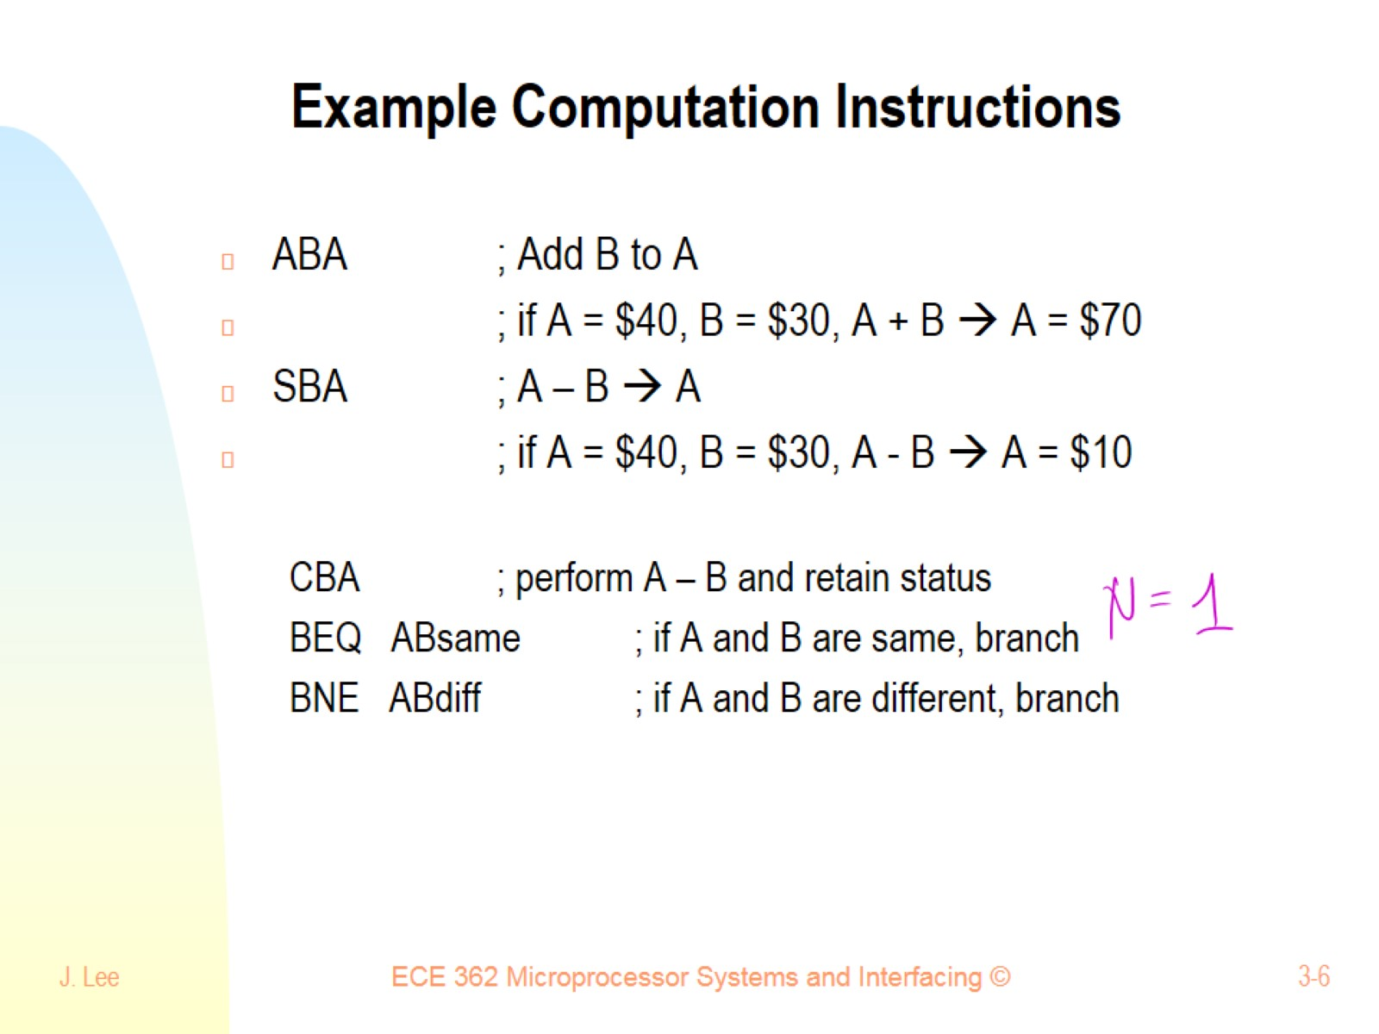
Example Computation Instructions

Slide 7
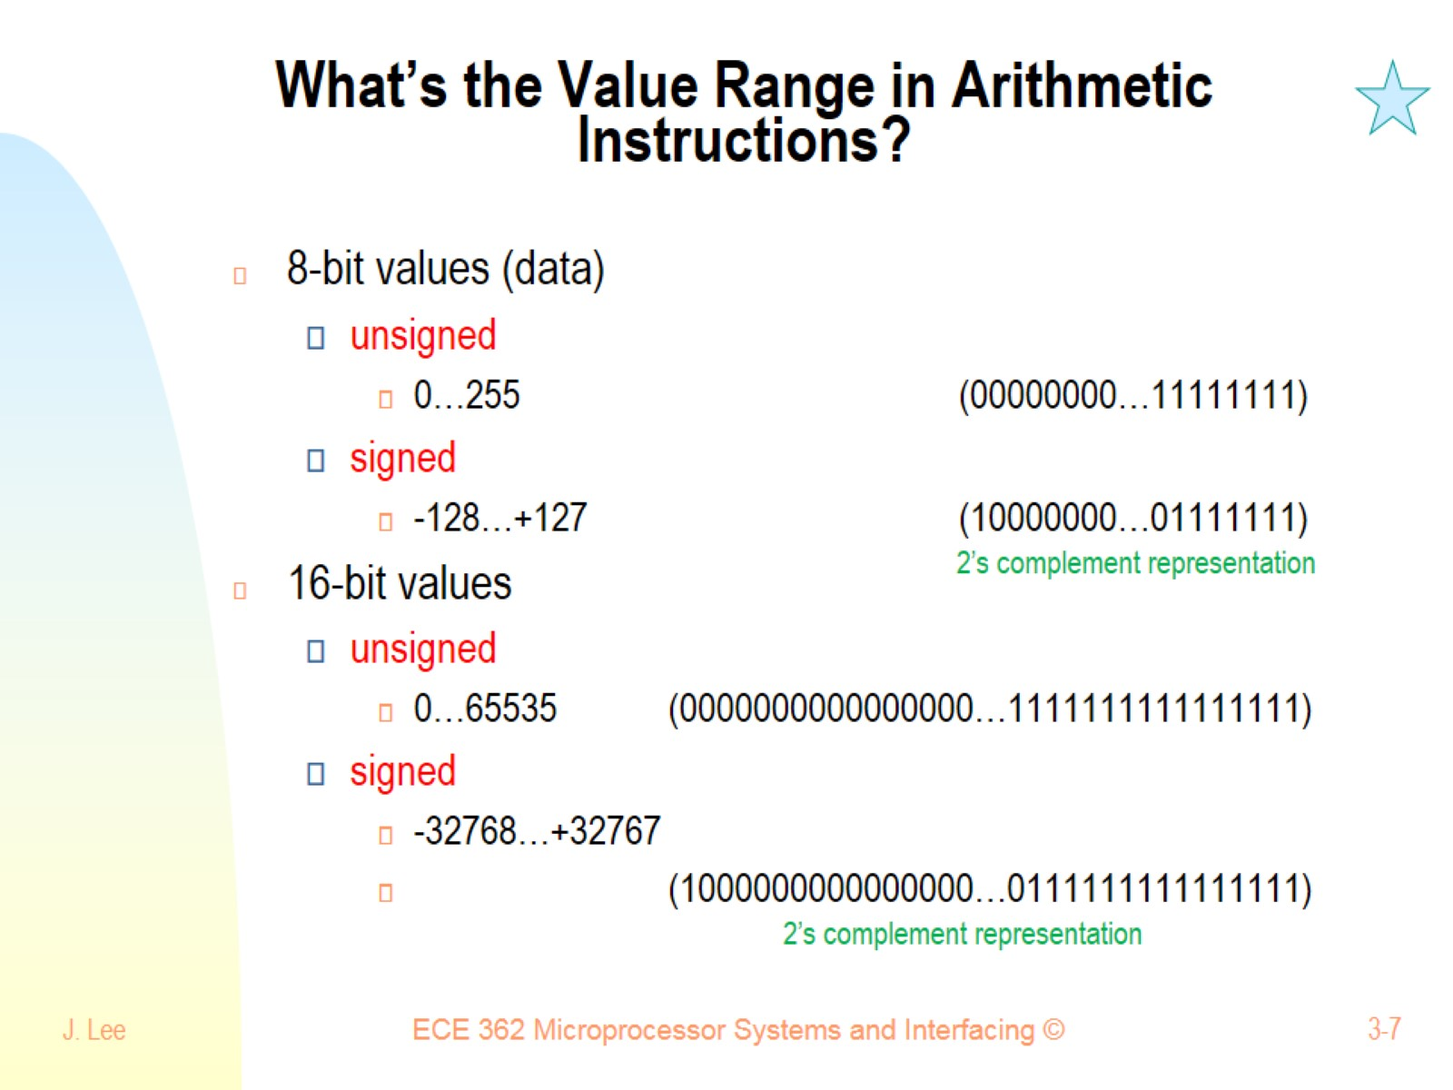
What’s the Value Range in Arithmetic Instructions?

Slide 8
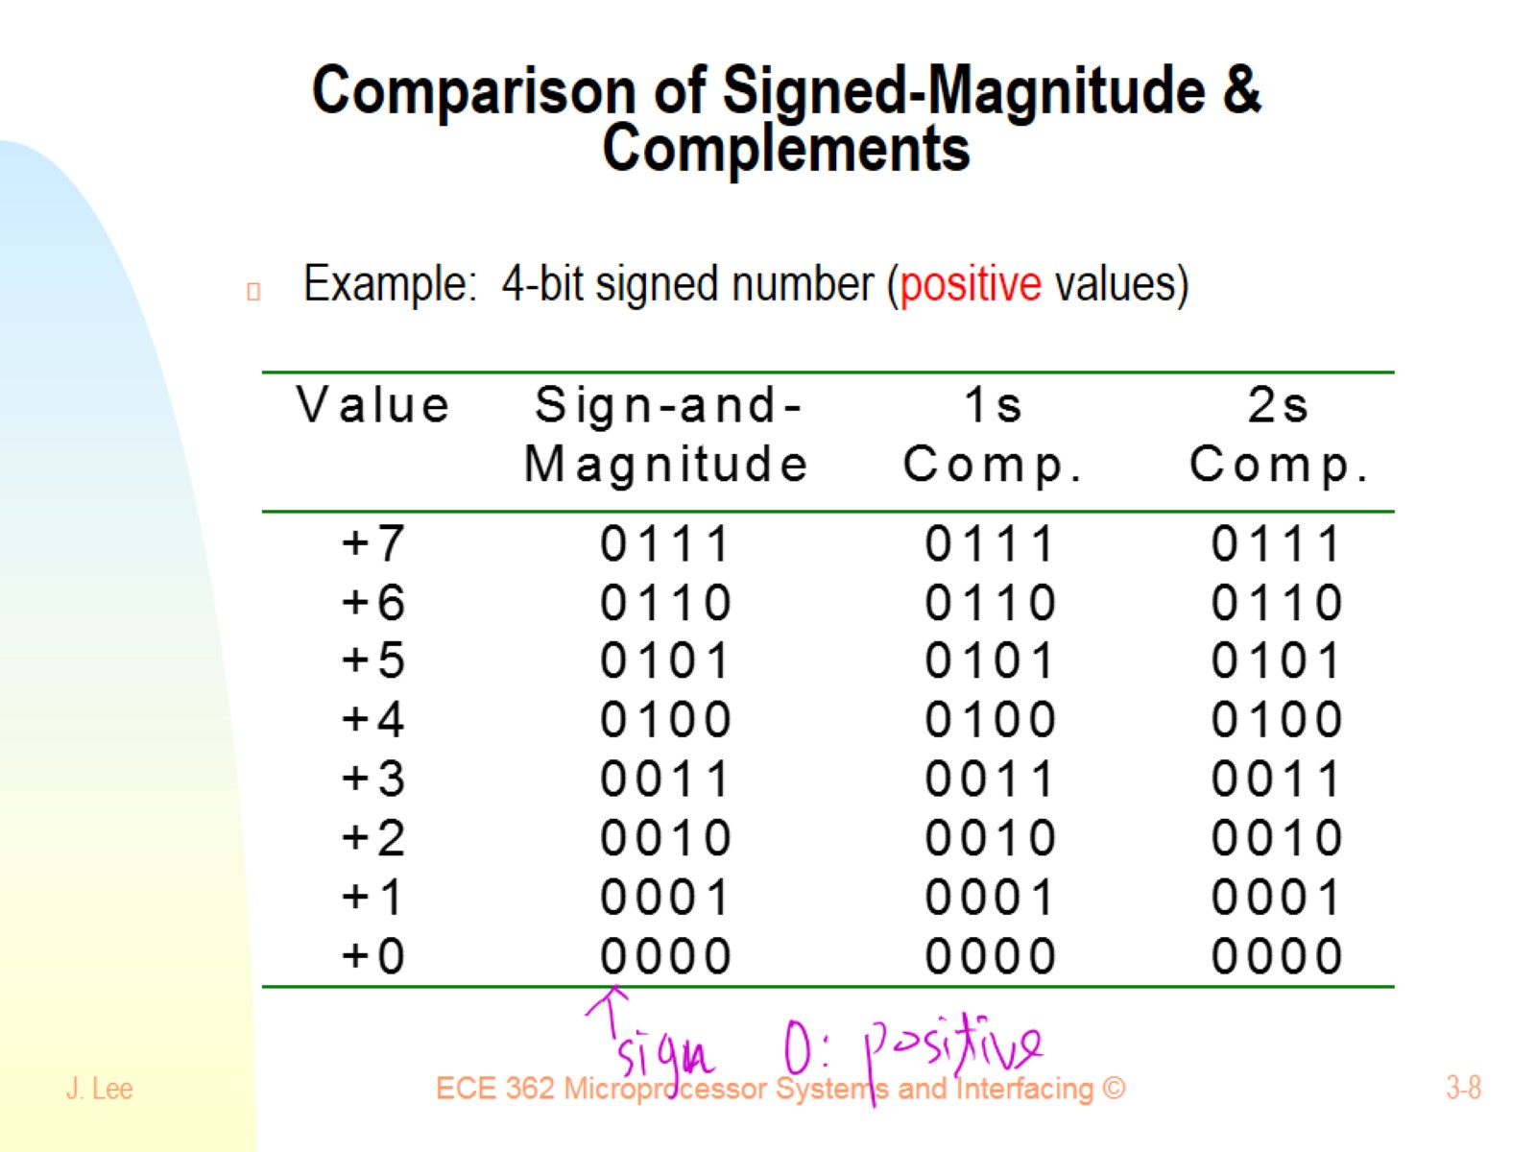
Comparison of Signed-Magnitude & Complements

Slide 9
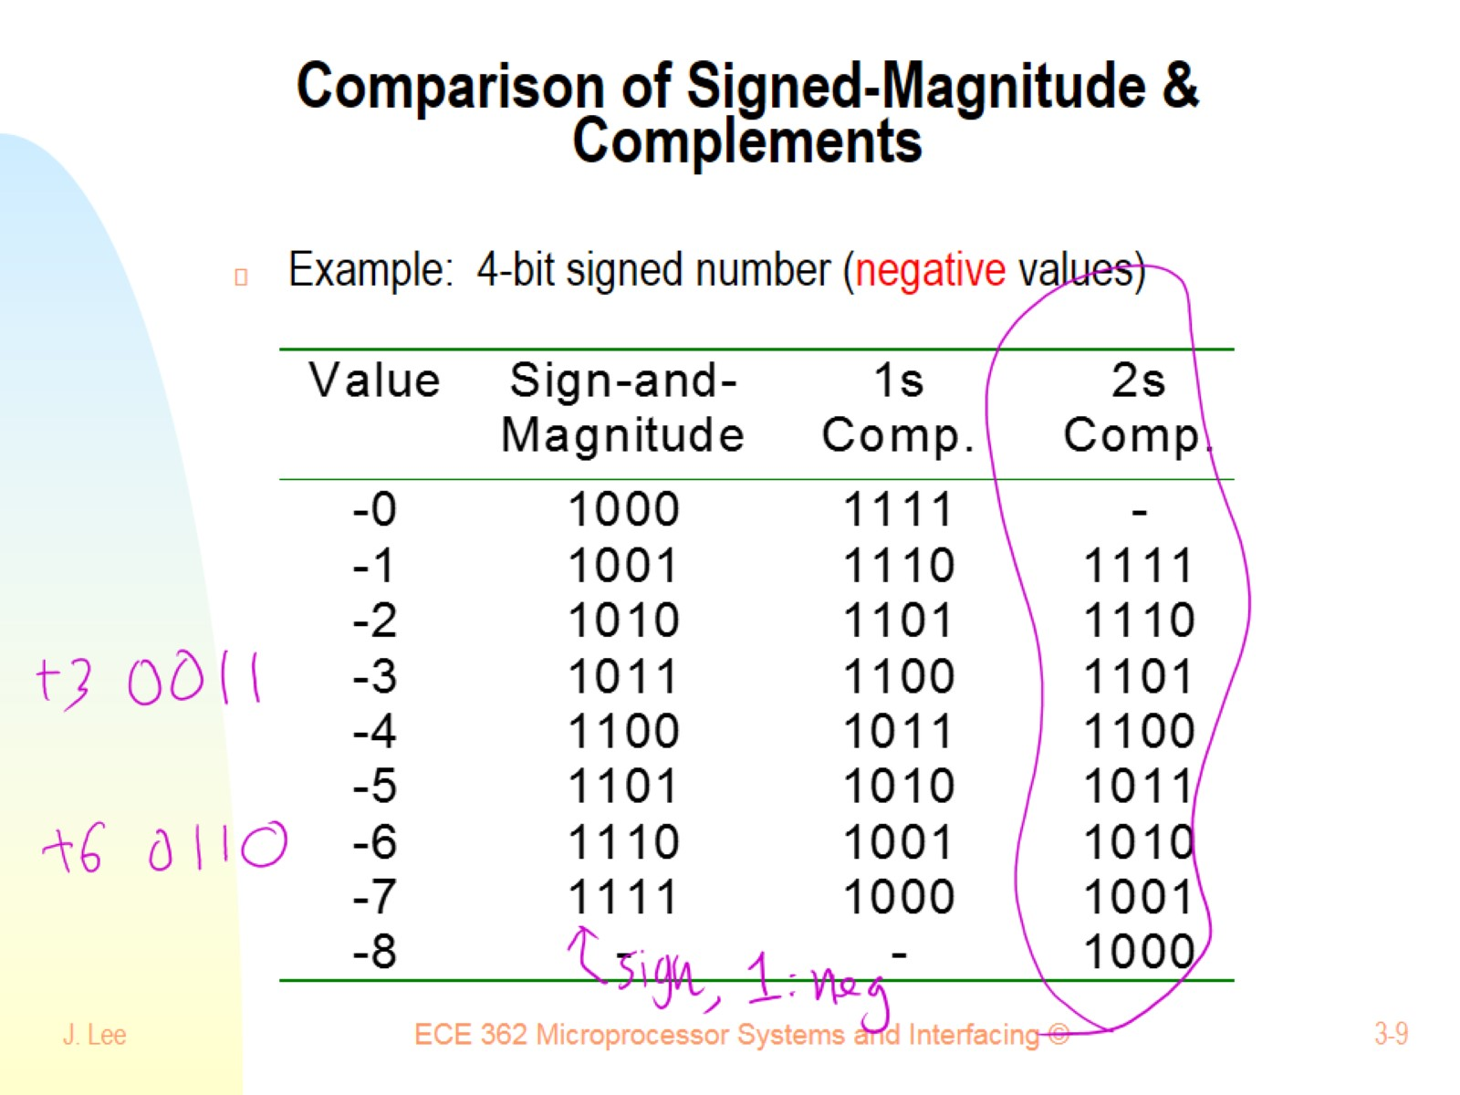
Comparison of Signed-Magnitude & Complements

Slide 10
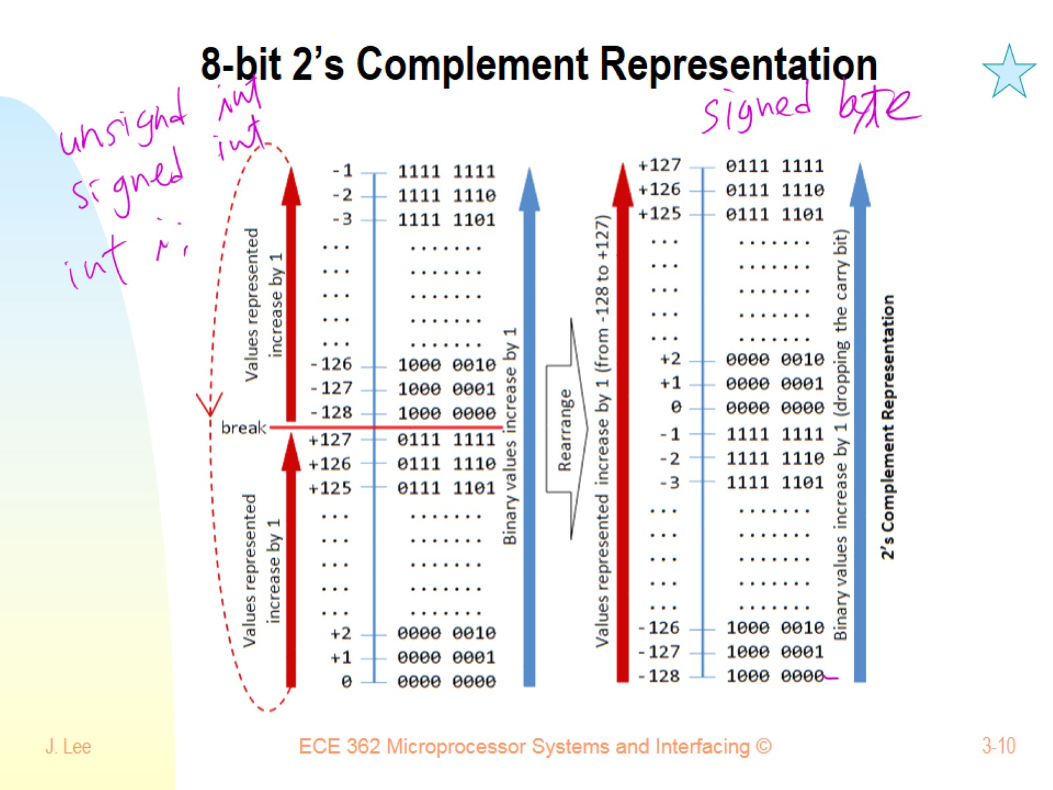
8-bit 2’s Complement Representation

Slide 11
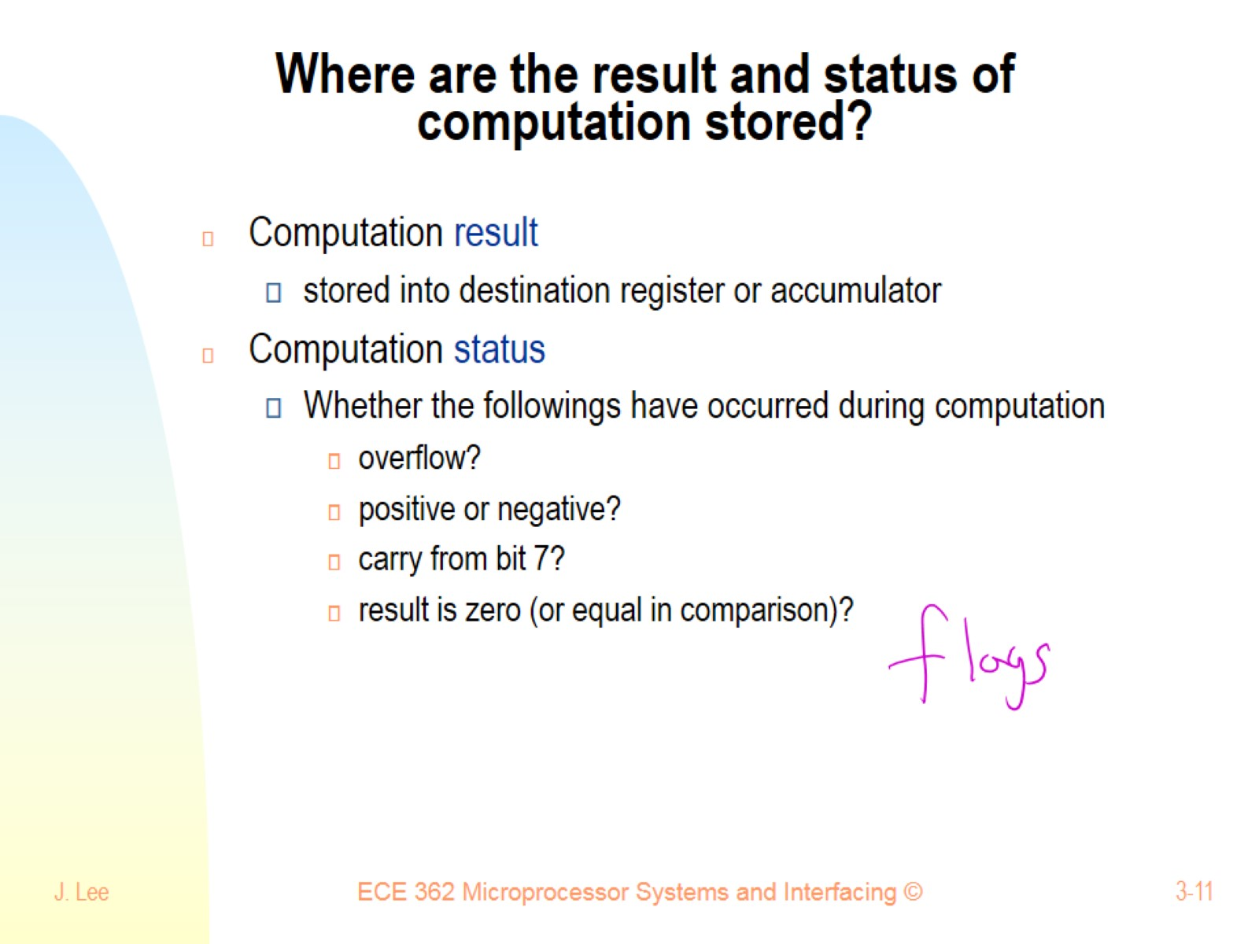
Where are the result and status of computation stored?

Slide 12
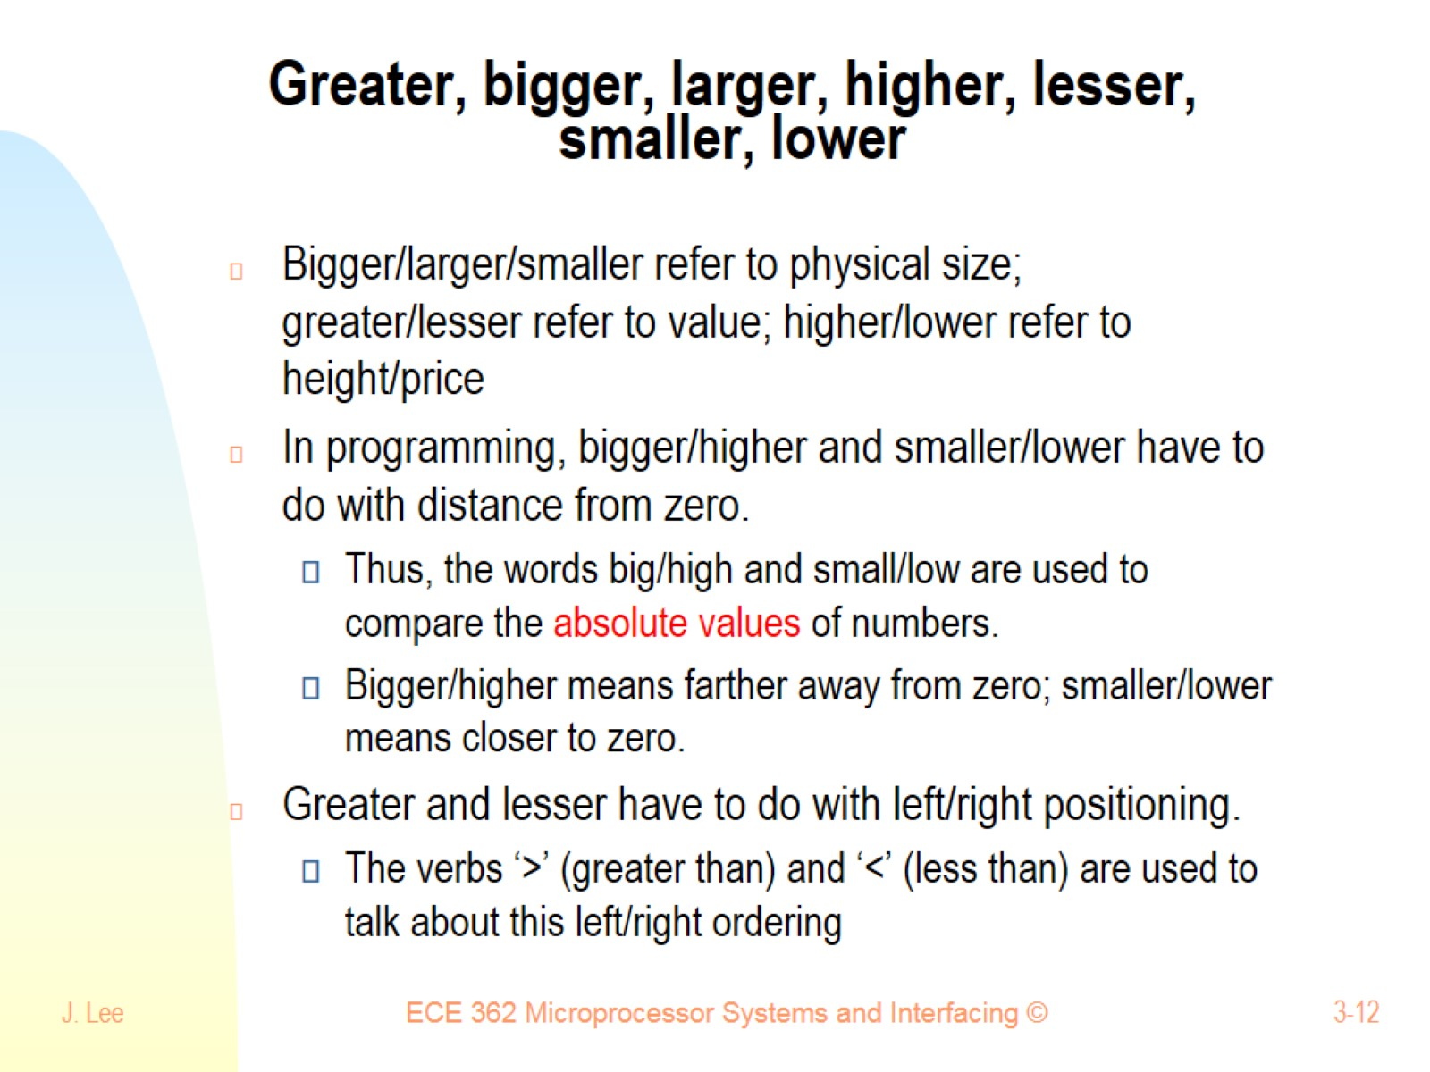
Greater, bigger, larger, higher, lesser, smaller, lower

Slide 13
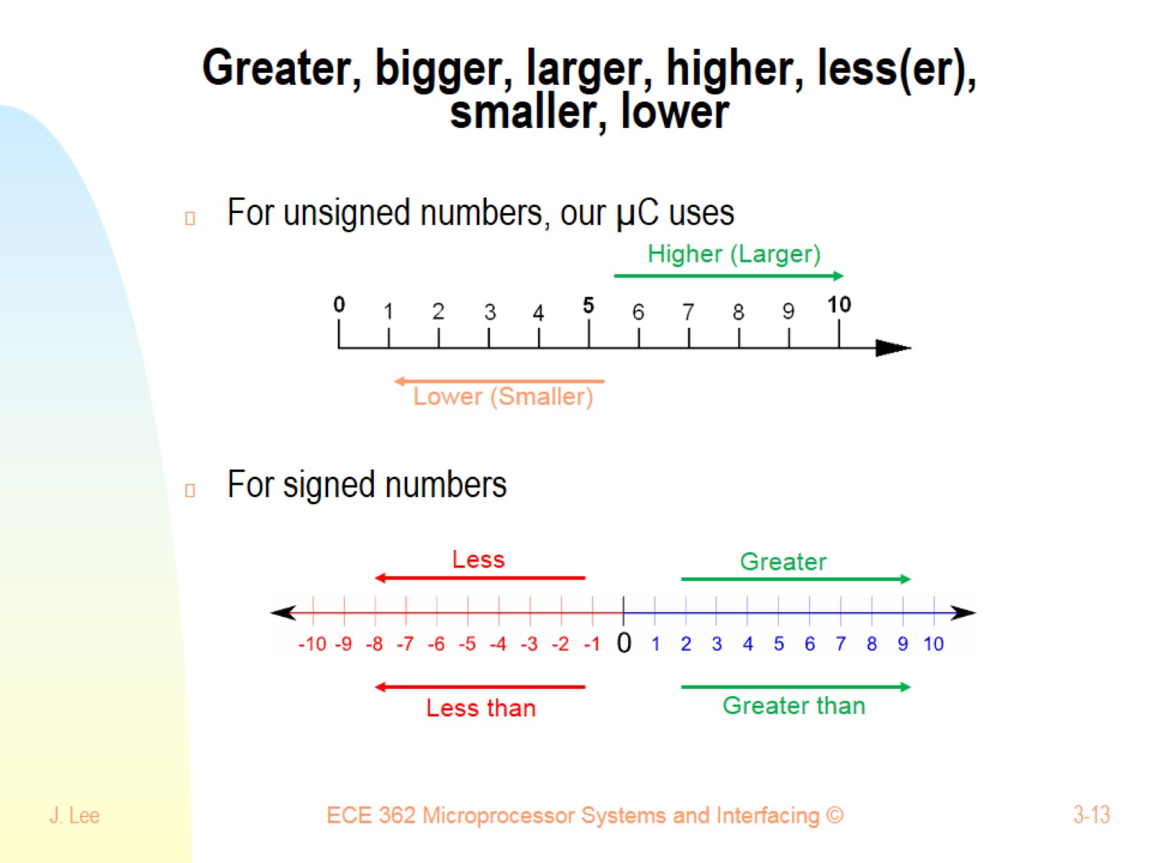
Greater, bigger, larger, higher, less(er), smaller, lower

Slide 14
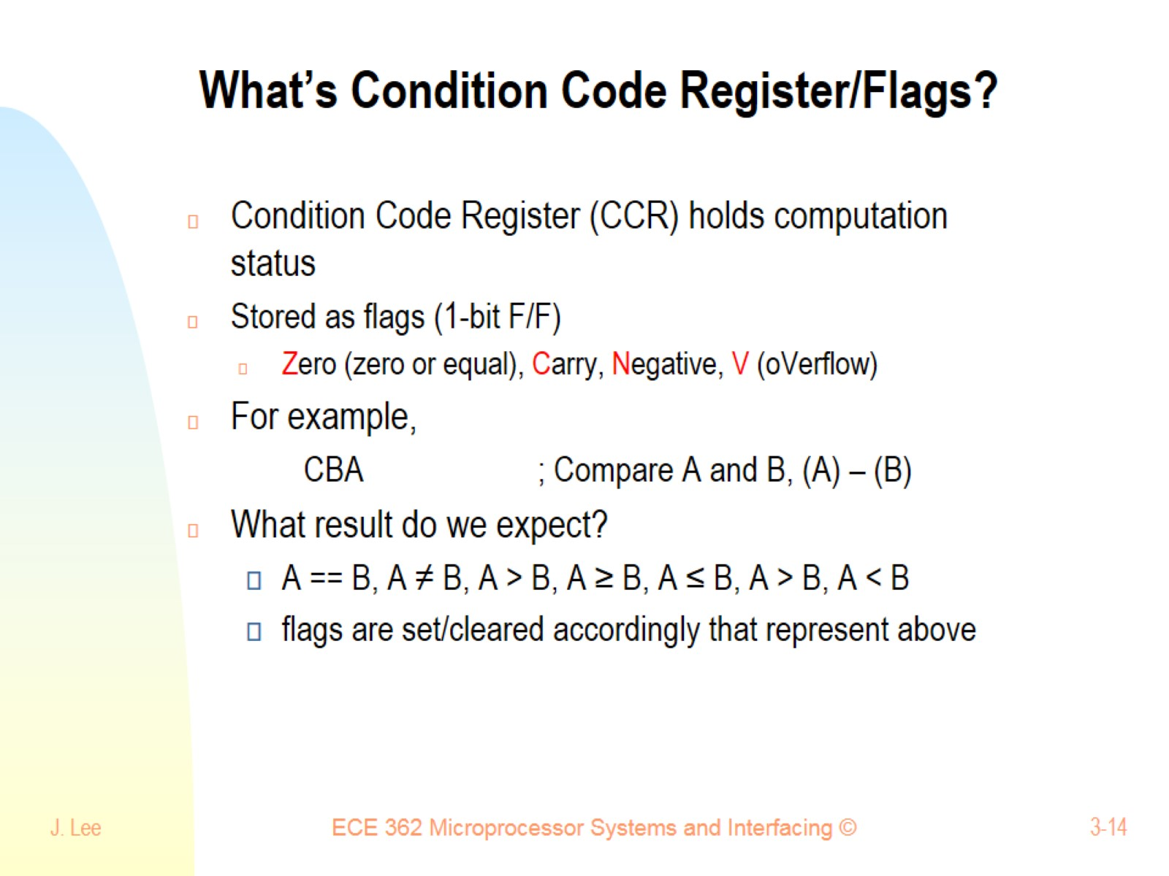
What’s Condition Code Register/Flags?

Slide 15
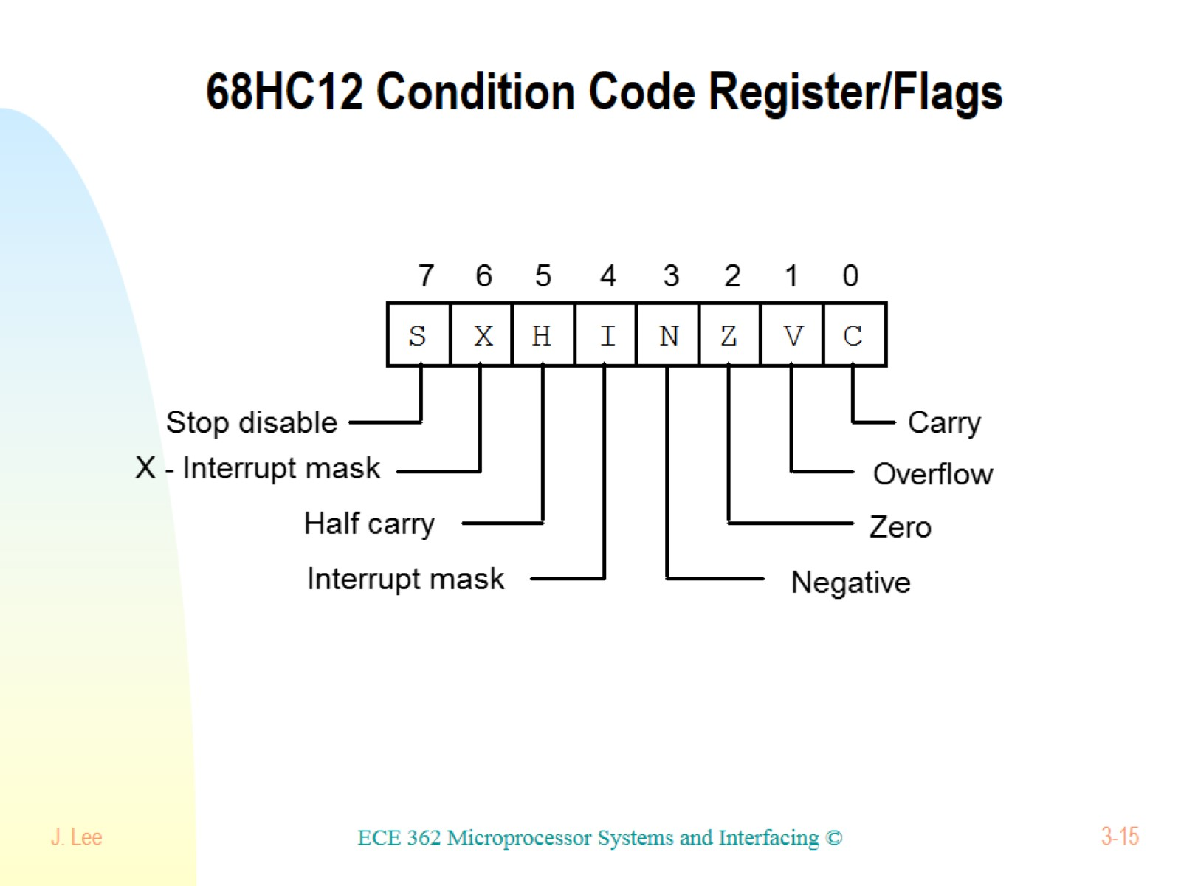
68HC12 Condition Code Register/Flags

Slide 16
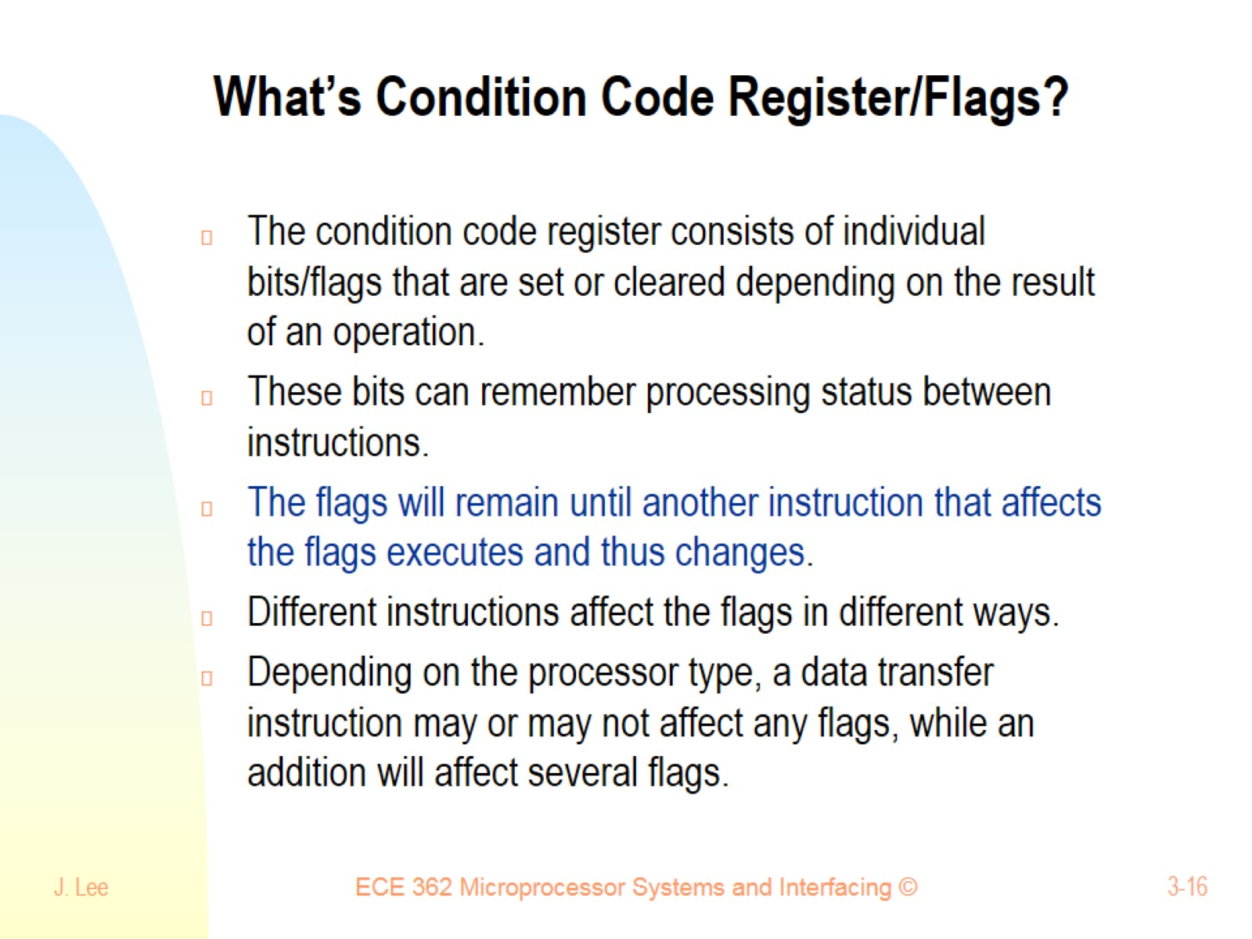
What’s Condition Code Register/Flags?

Slide 17
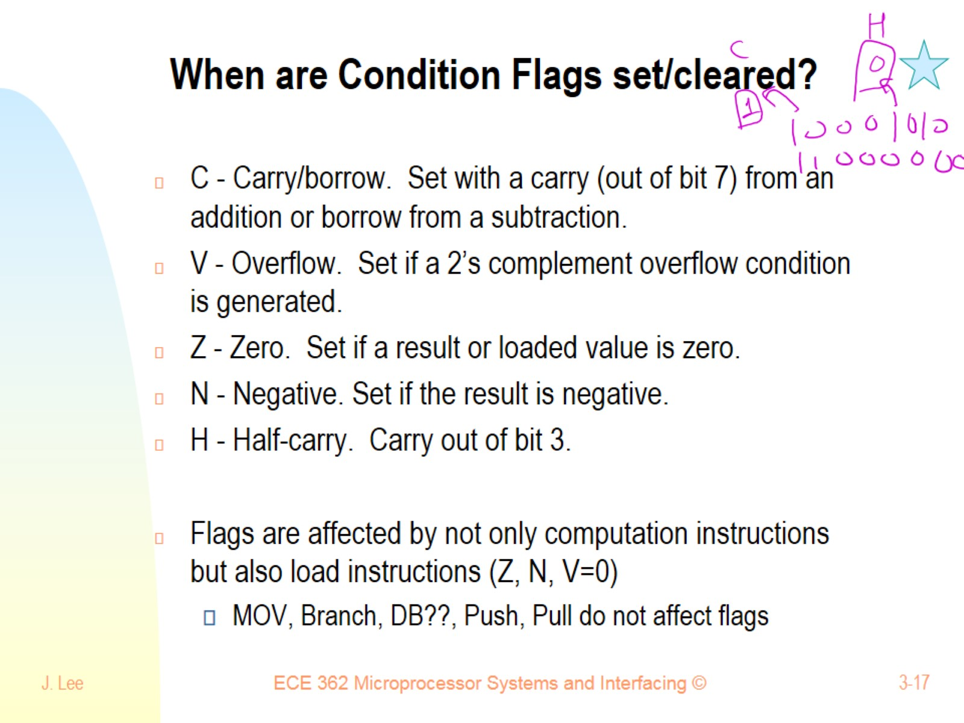
When are Condition Flags set/cleared?

Slide 18
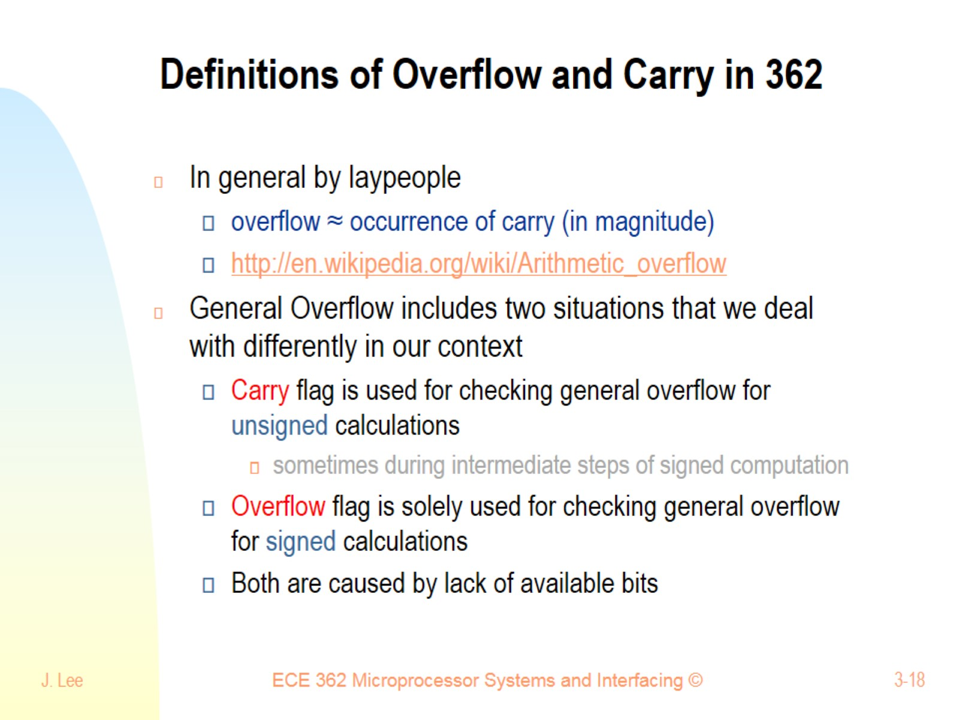
Definitions of Overflow and Carry in 362

Slide 19
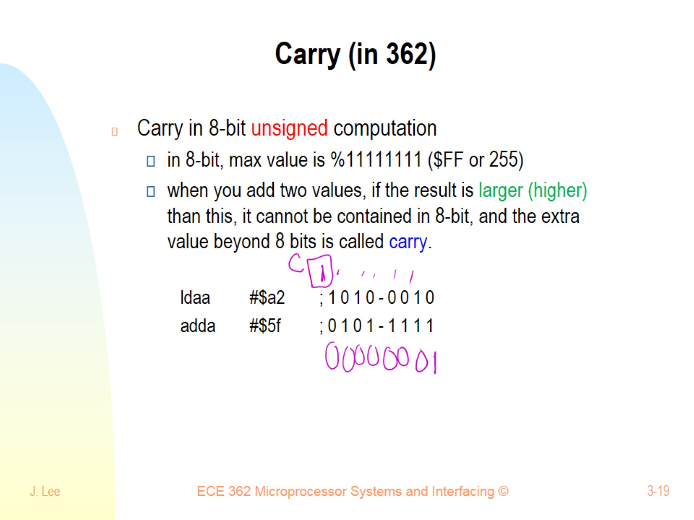
Carry (in 362)

Slide 20
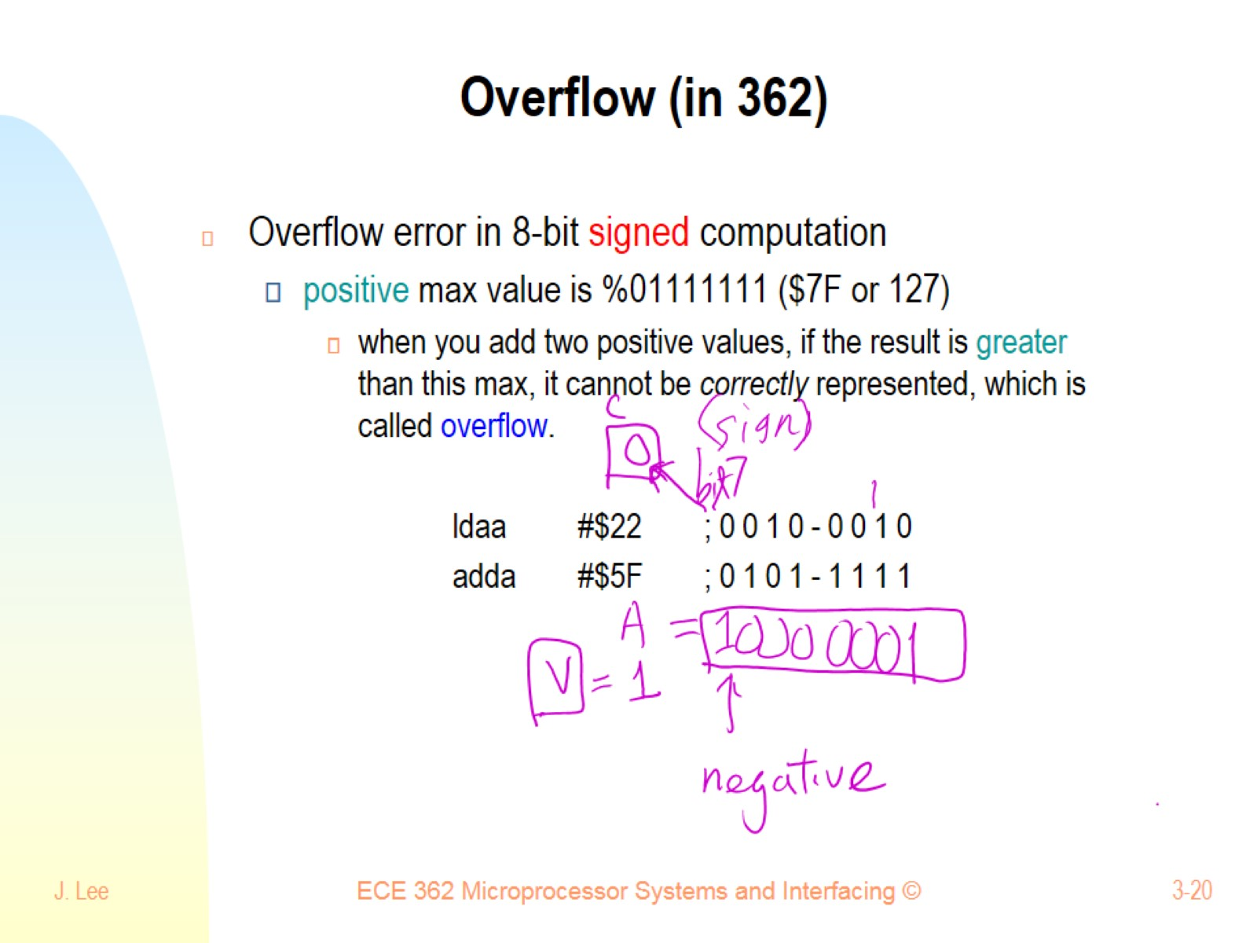
Overflow (in 362)

Slide 21
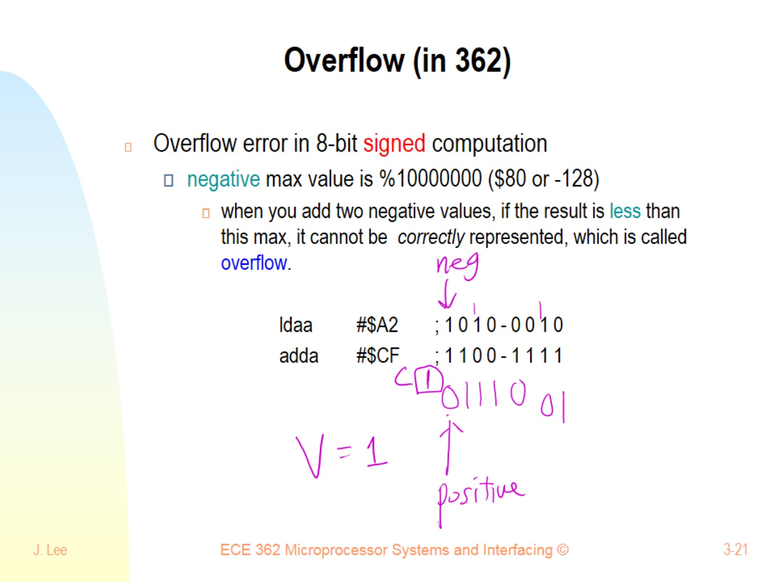
Overflow (in 362)

Slide 22
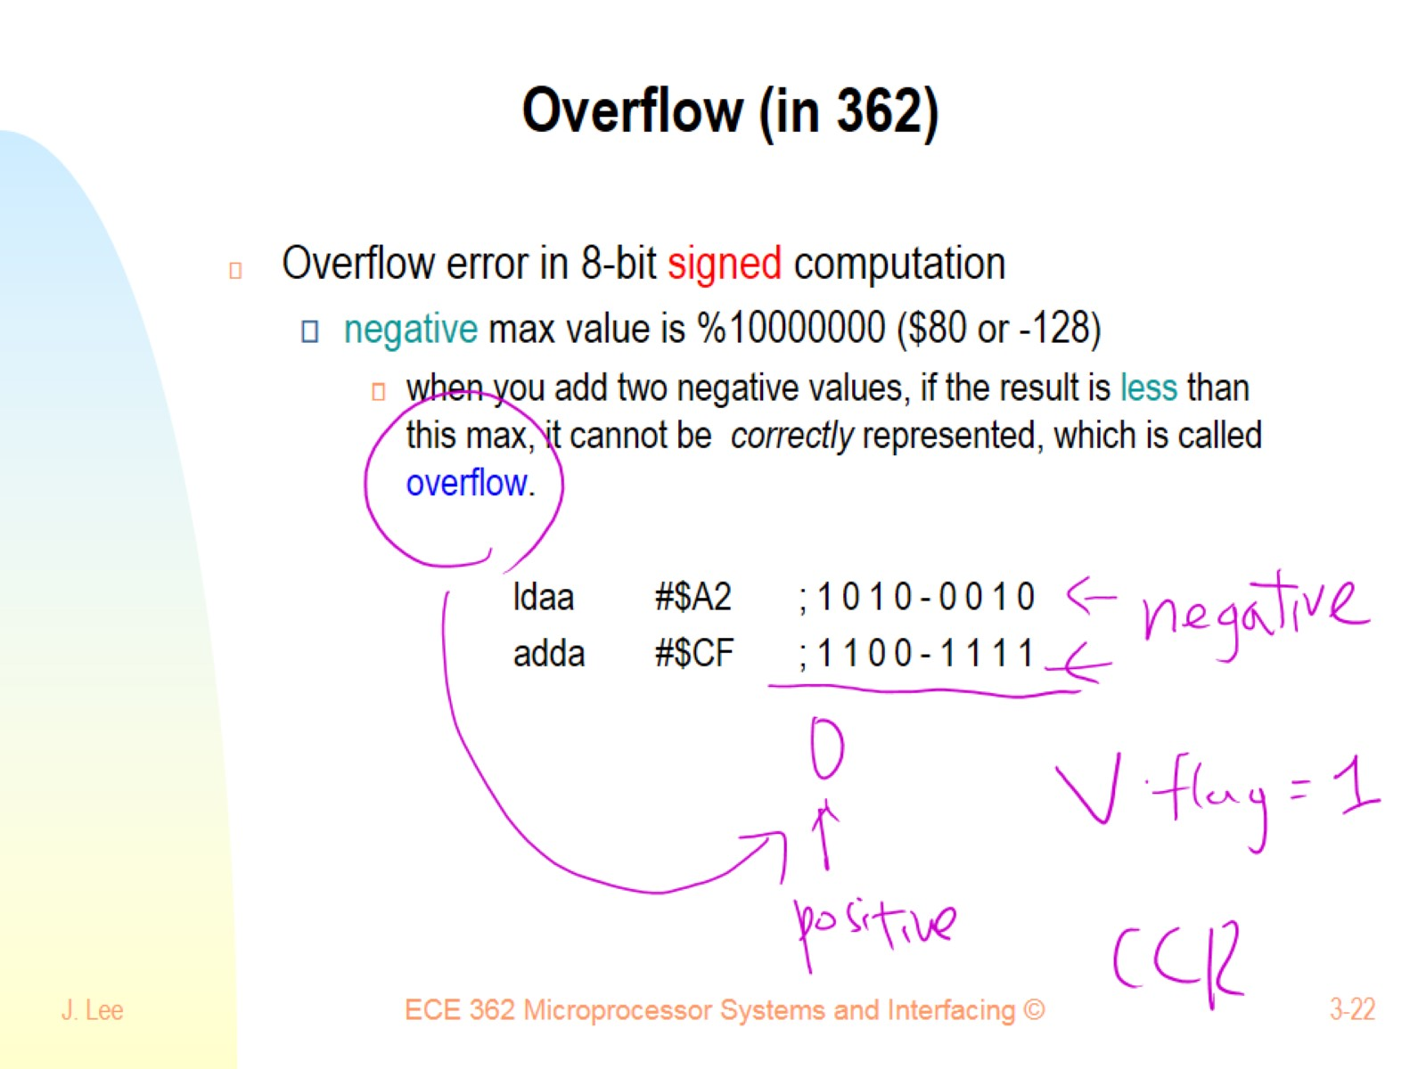
Overflow (in 362)

Slide 23
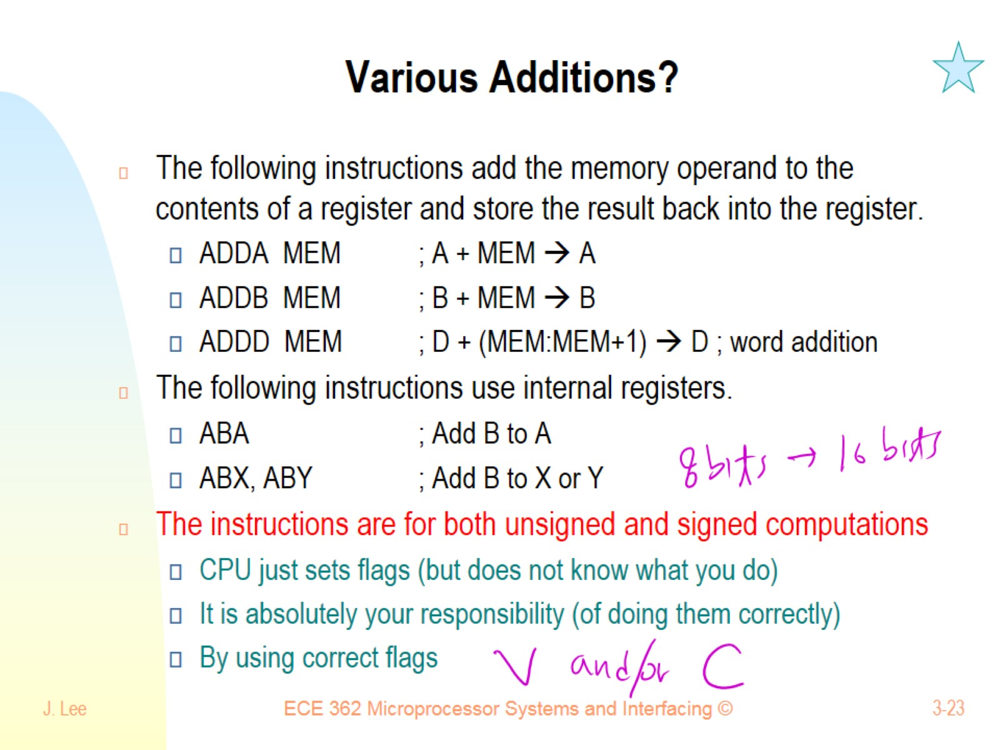
Various Additions?

Slide 24
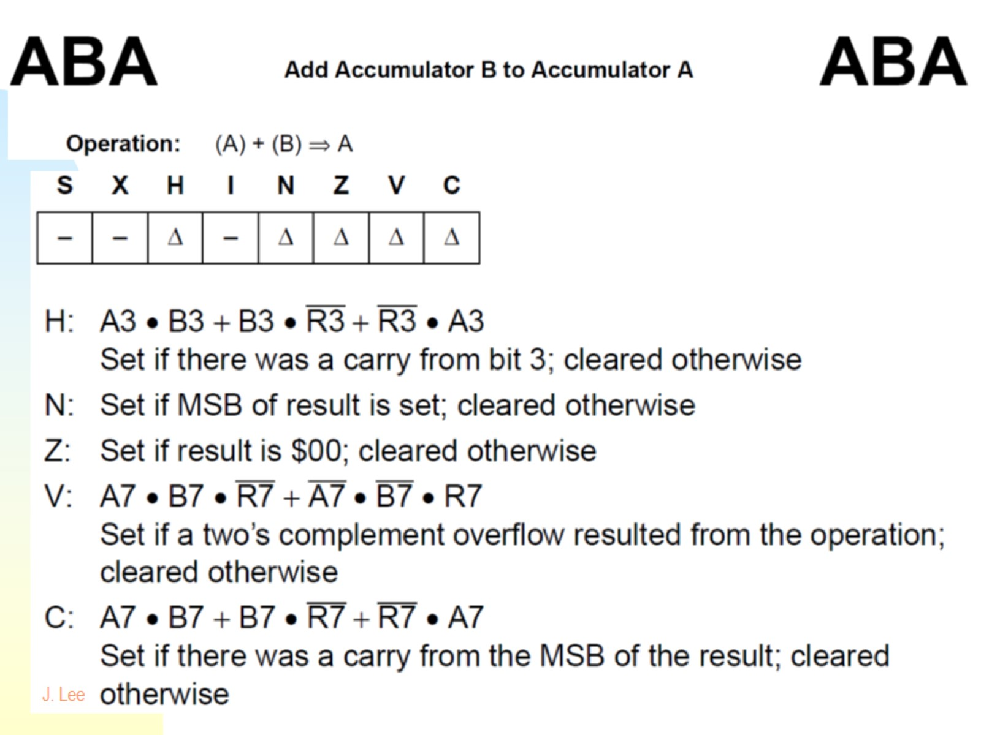

Slide 25
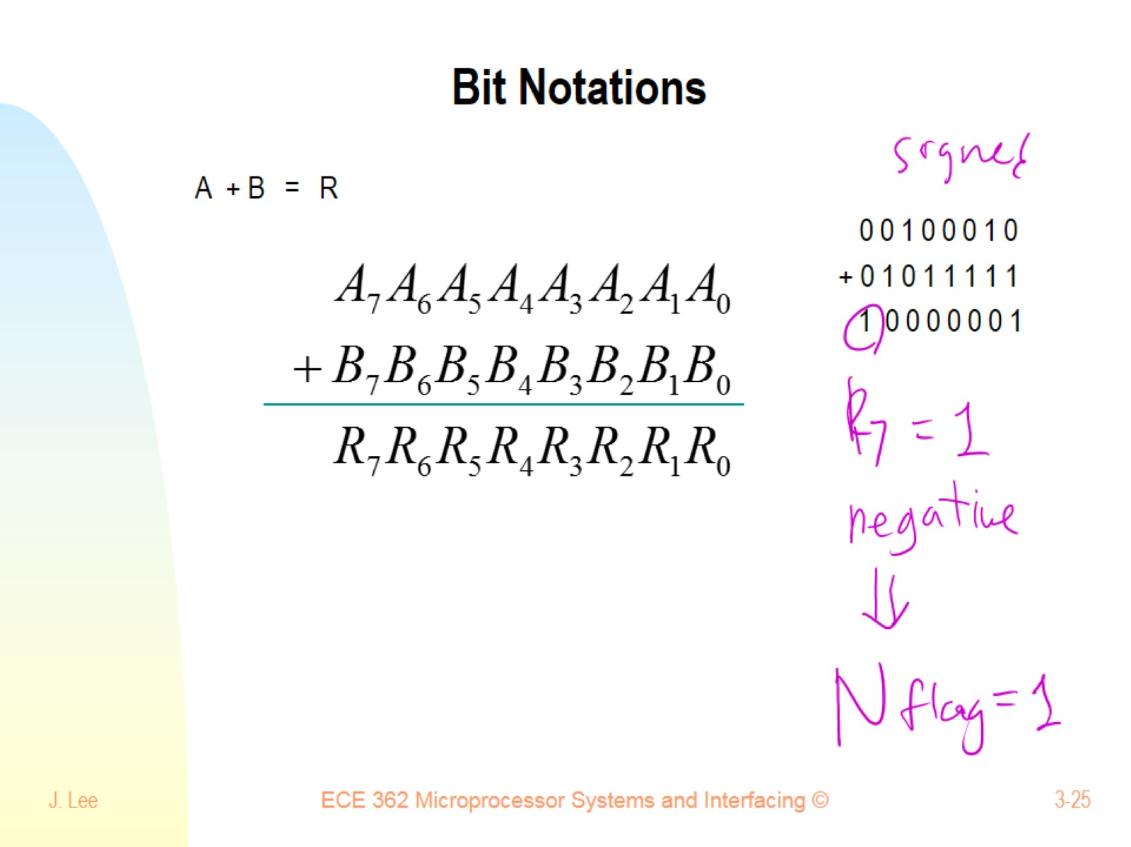
Bit Notations

Slide 26
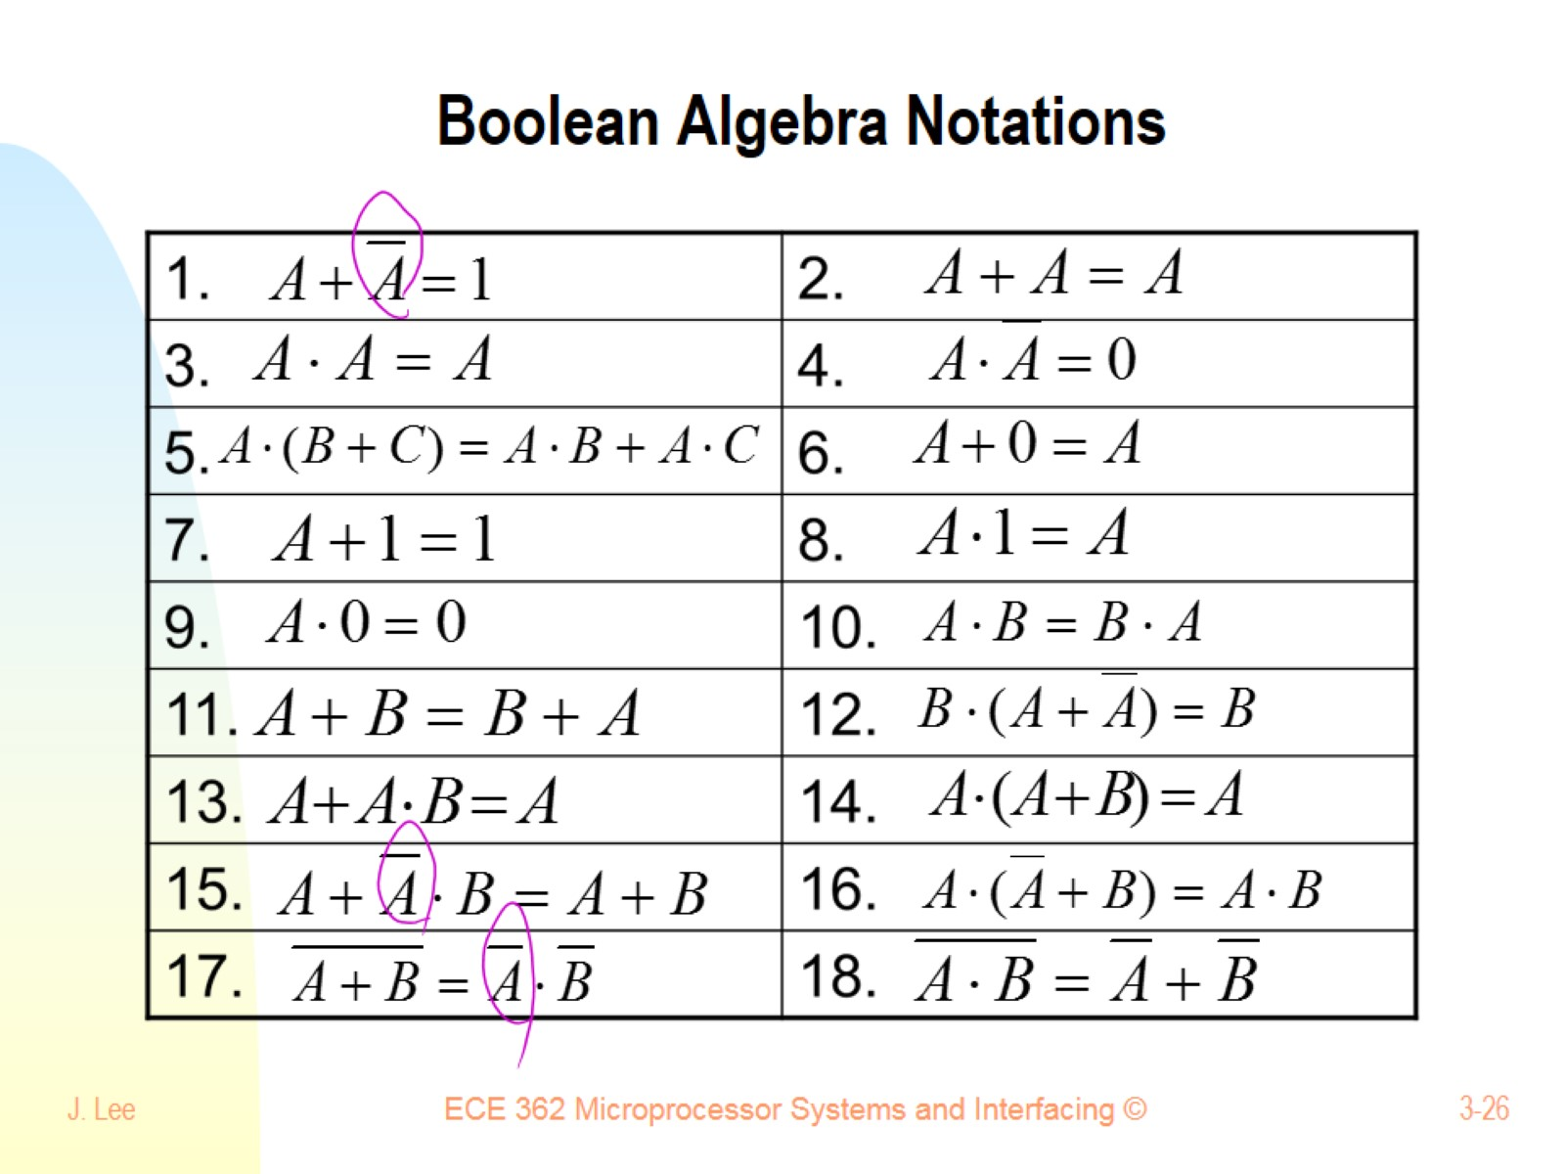
Boolean Algebra Notations

Slide 27
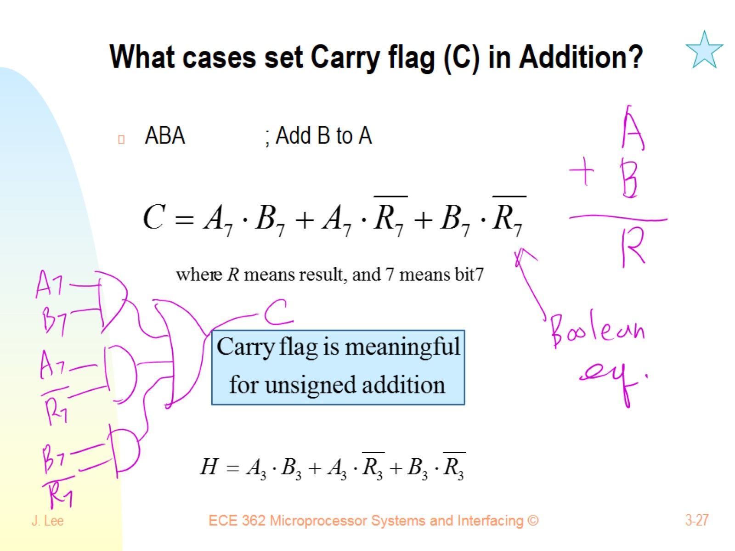
What cases set Carry flag (C) in Addition?

Slide 28
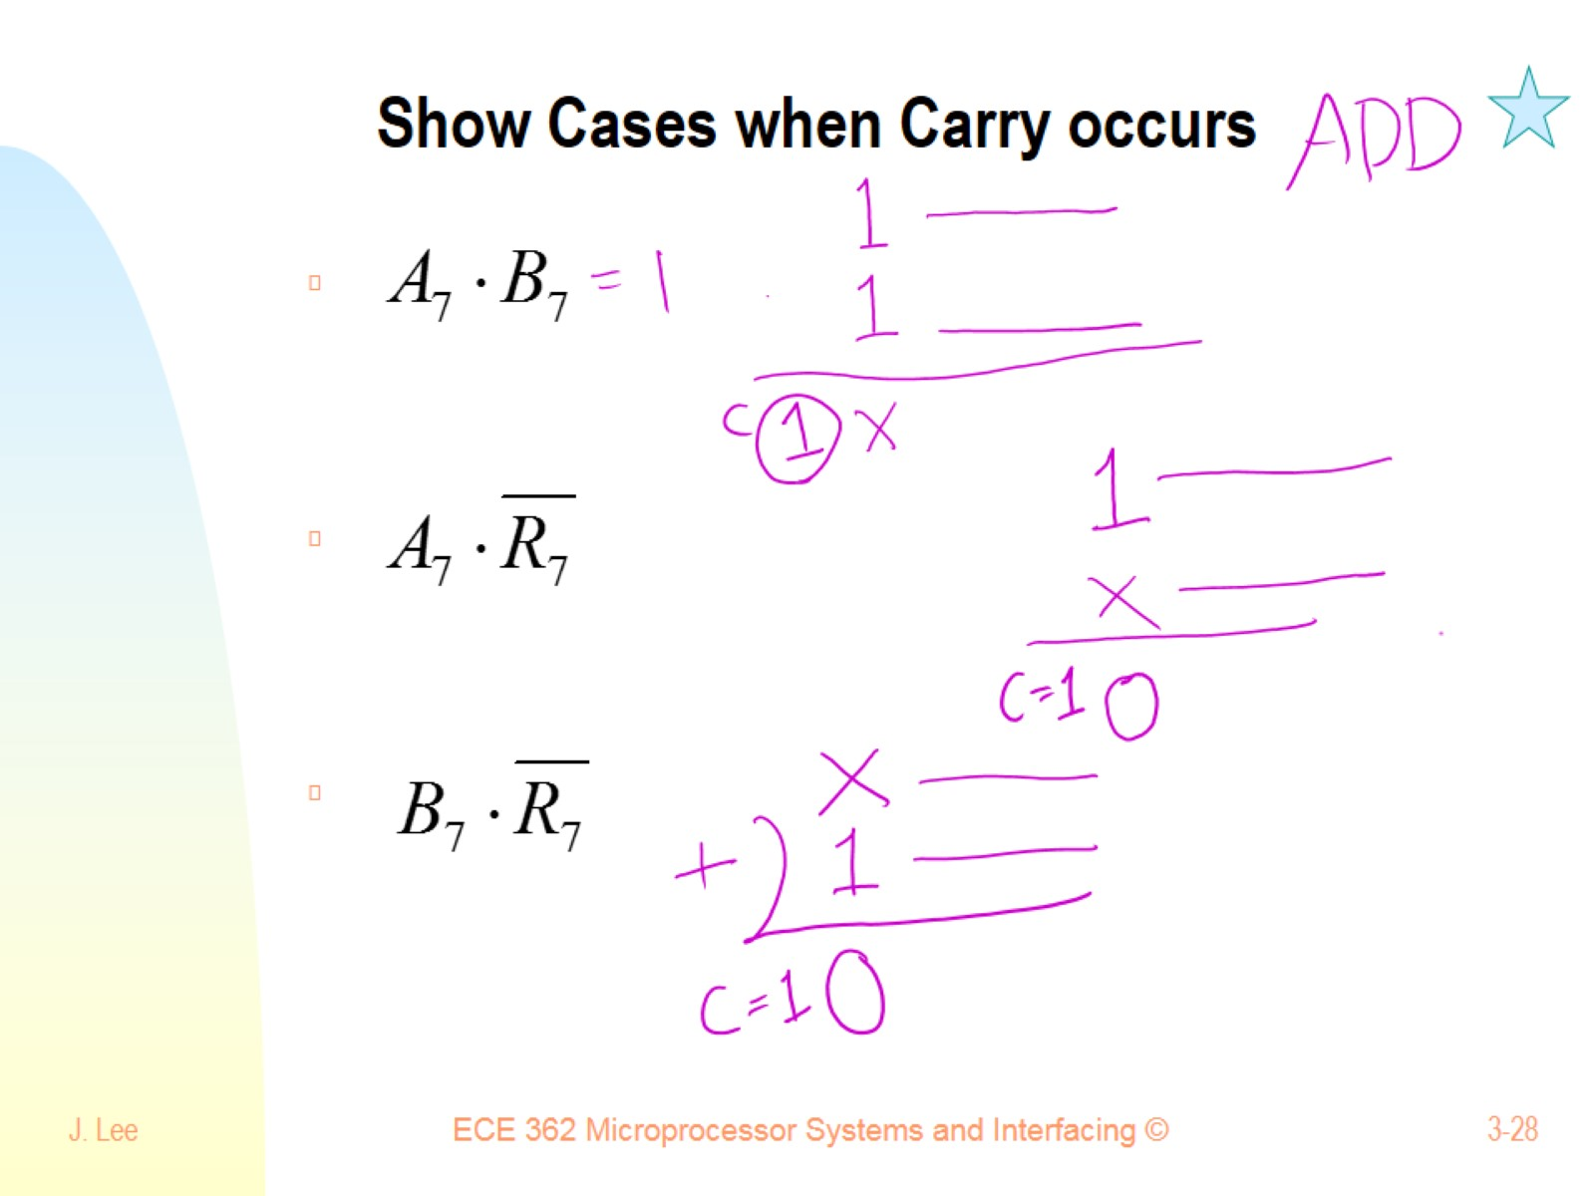
Show Cases when Carry occurs

Slide 29
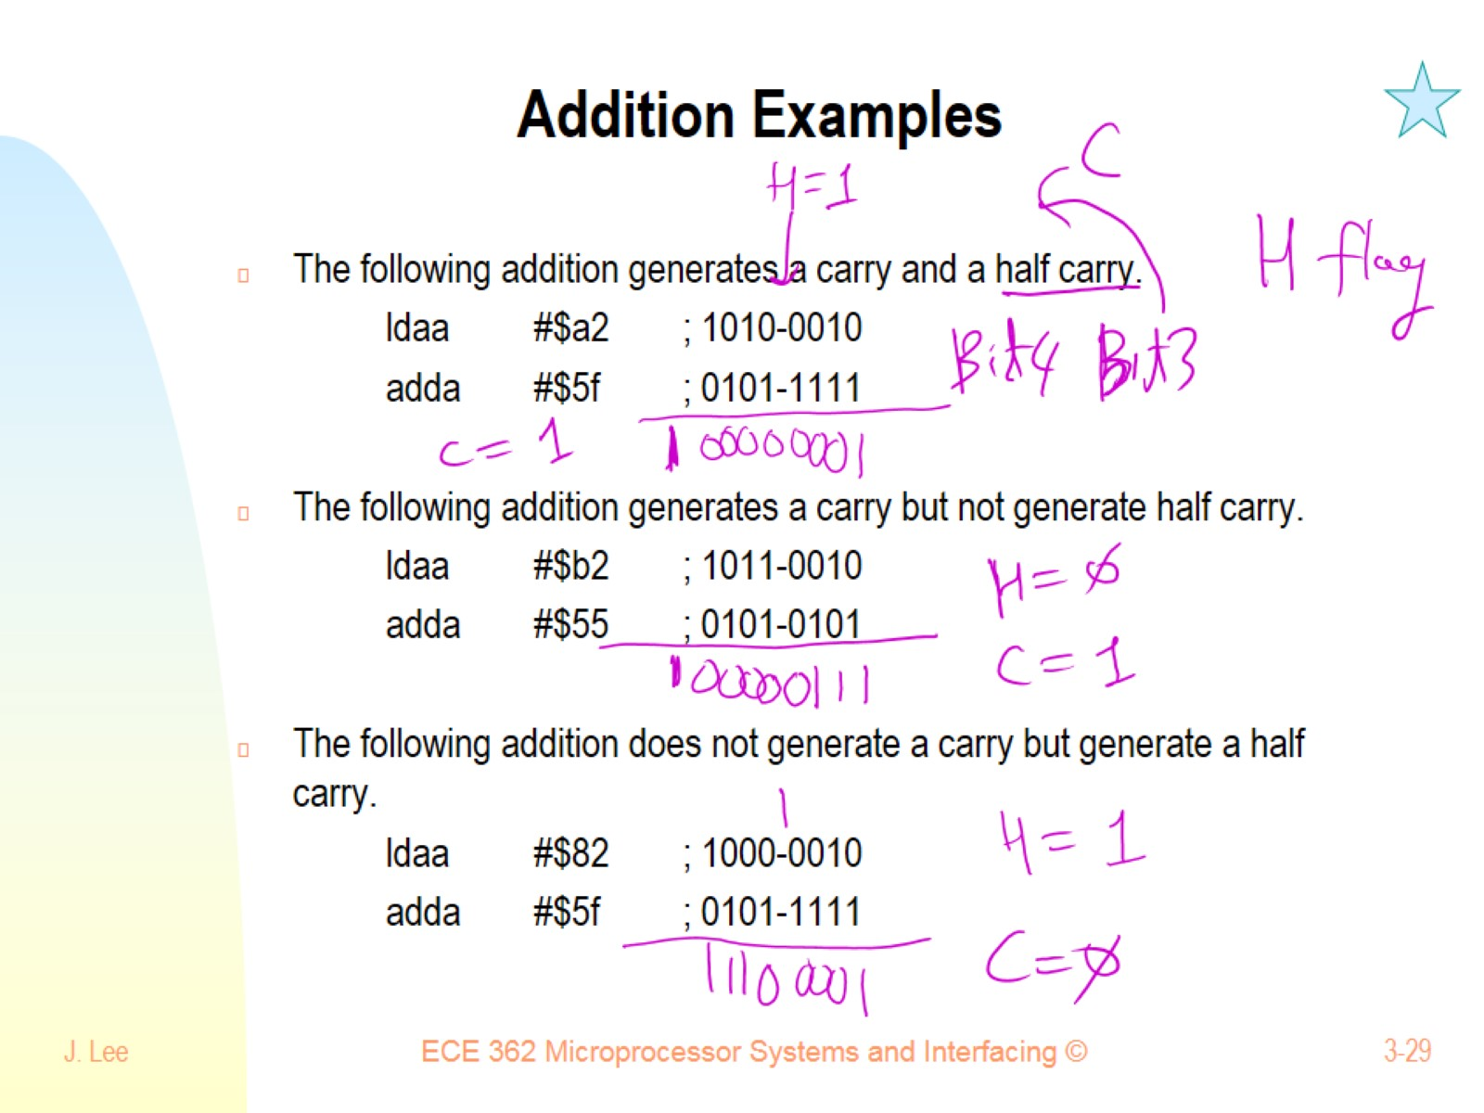
Addition Examples

Slide 30
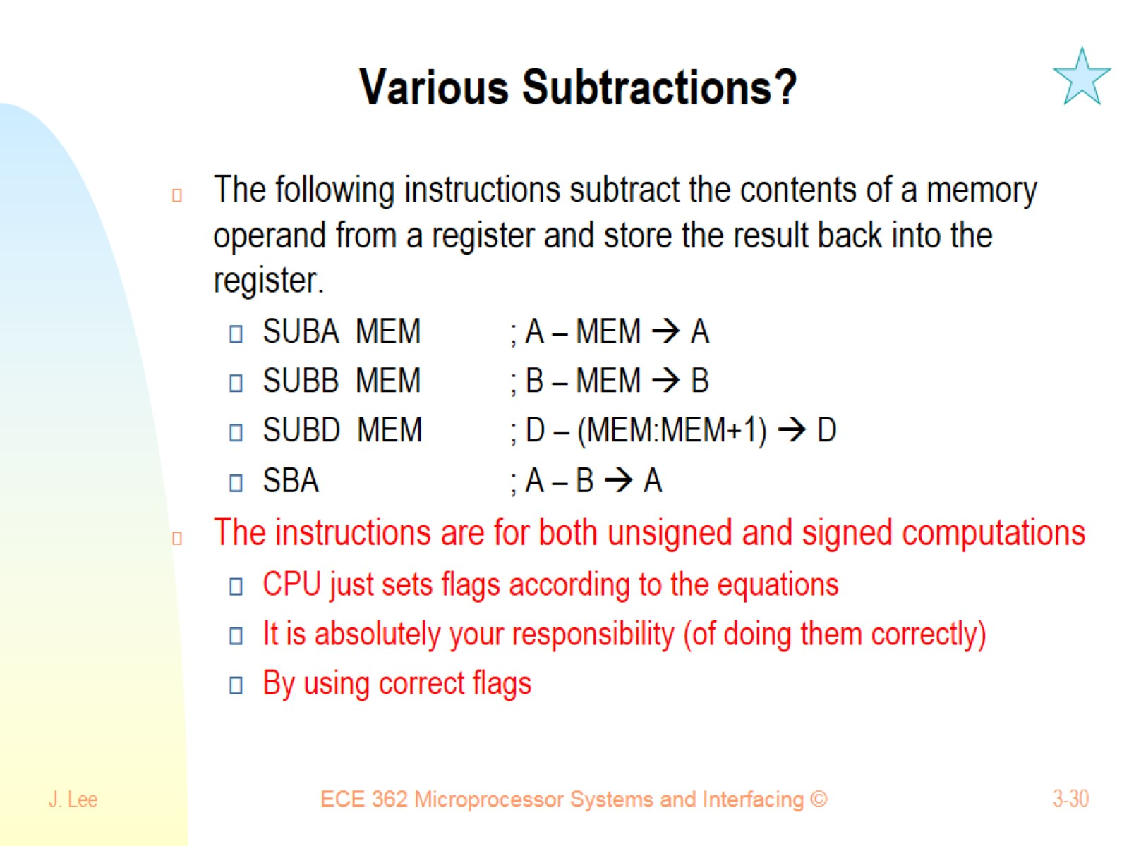
Various Subtractions?

Slide 31
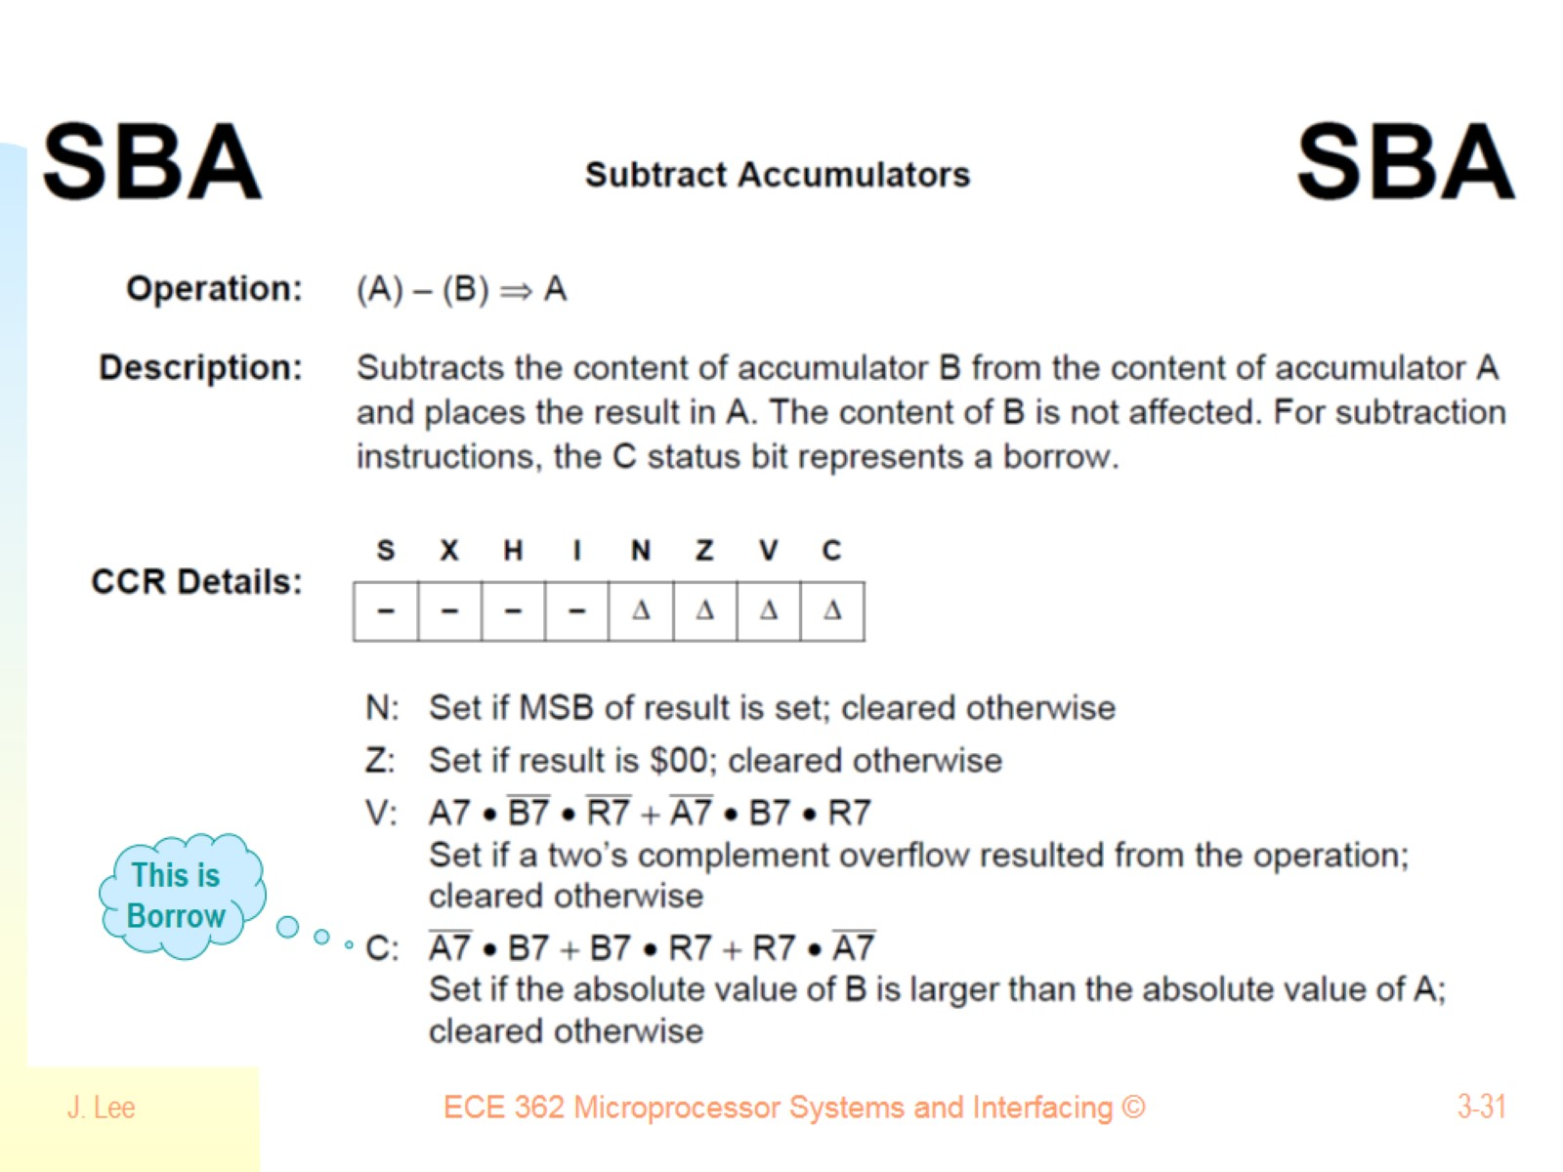

Slide 32
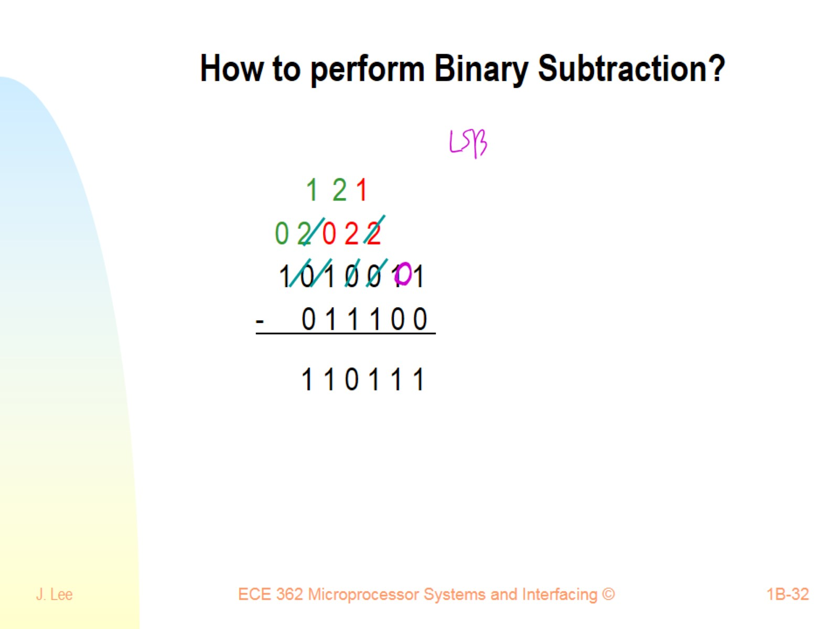
How to perform Binary Subtraction?

Slide 33
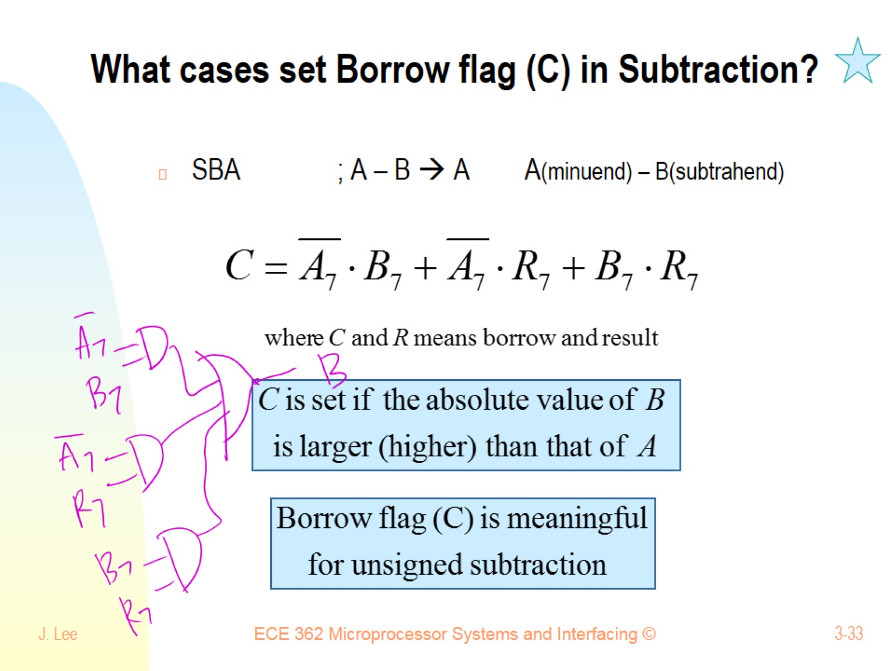
What cases set Borrow flag (C) in Subtraction?

Slide 34
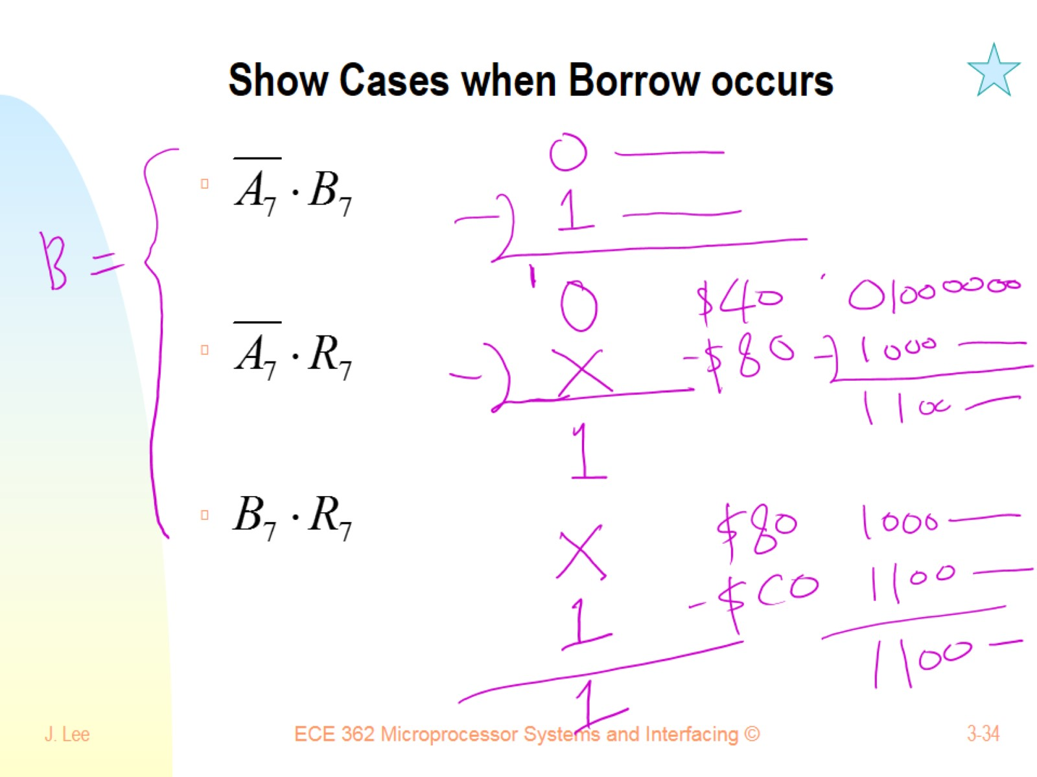
Show Cases when Borrow occurs

Slide 35
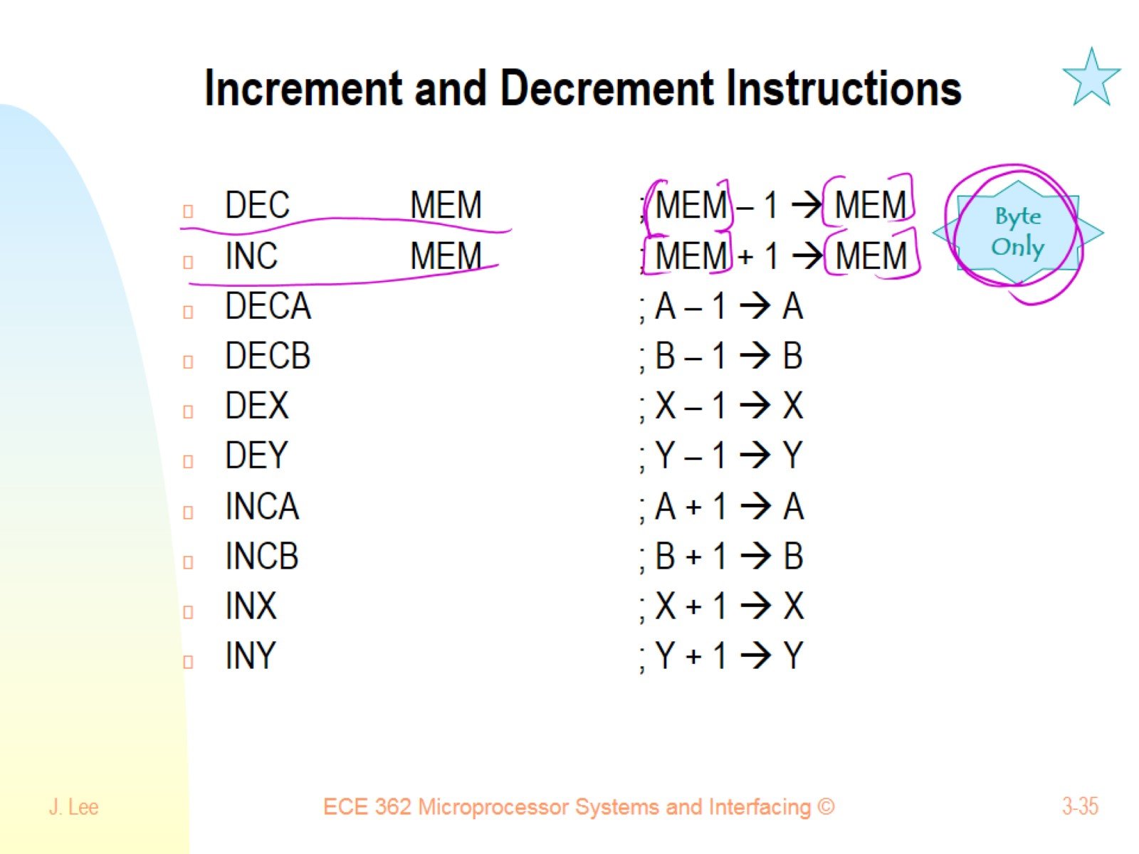
Increment and Decrement Instructions

Slide 36
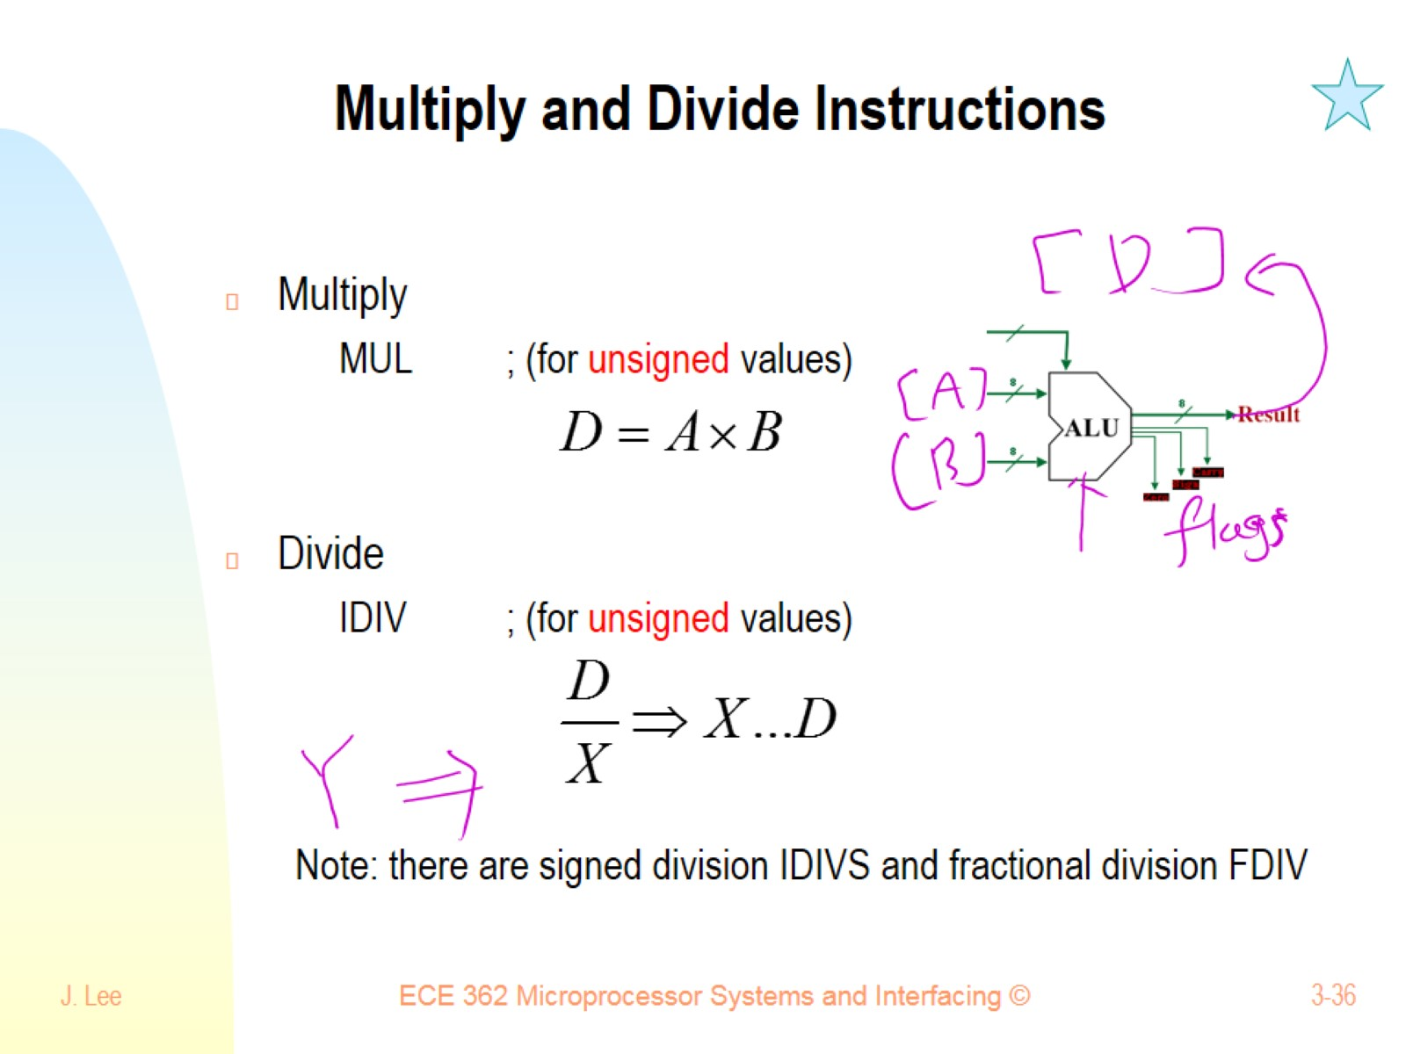
Multiply and Divide Instructions

Slide 37
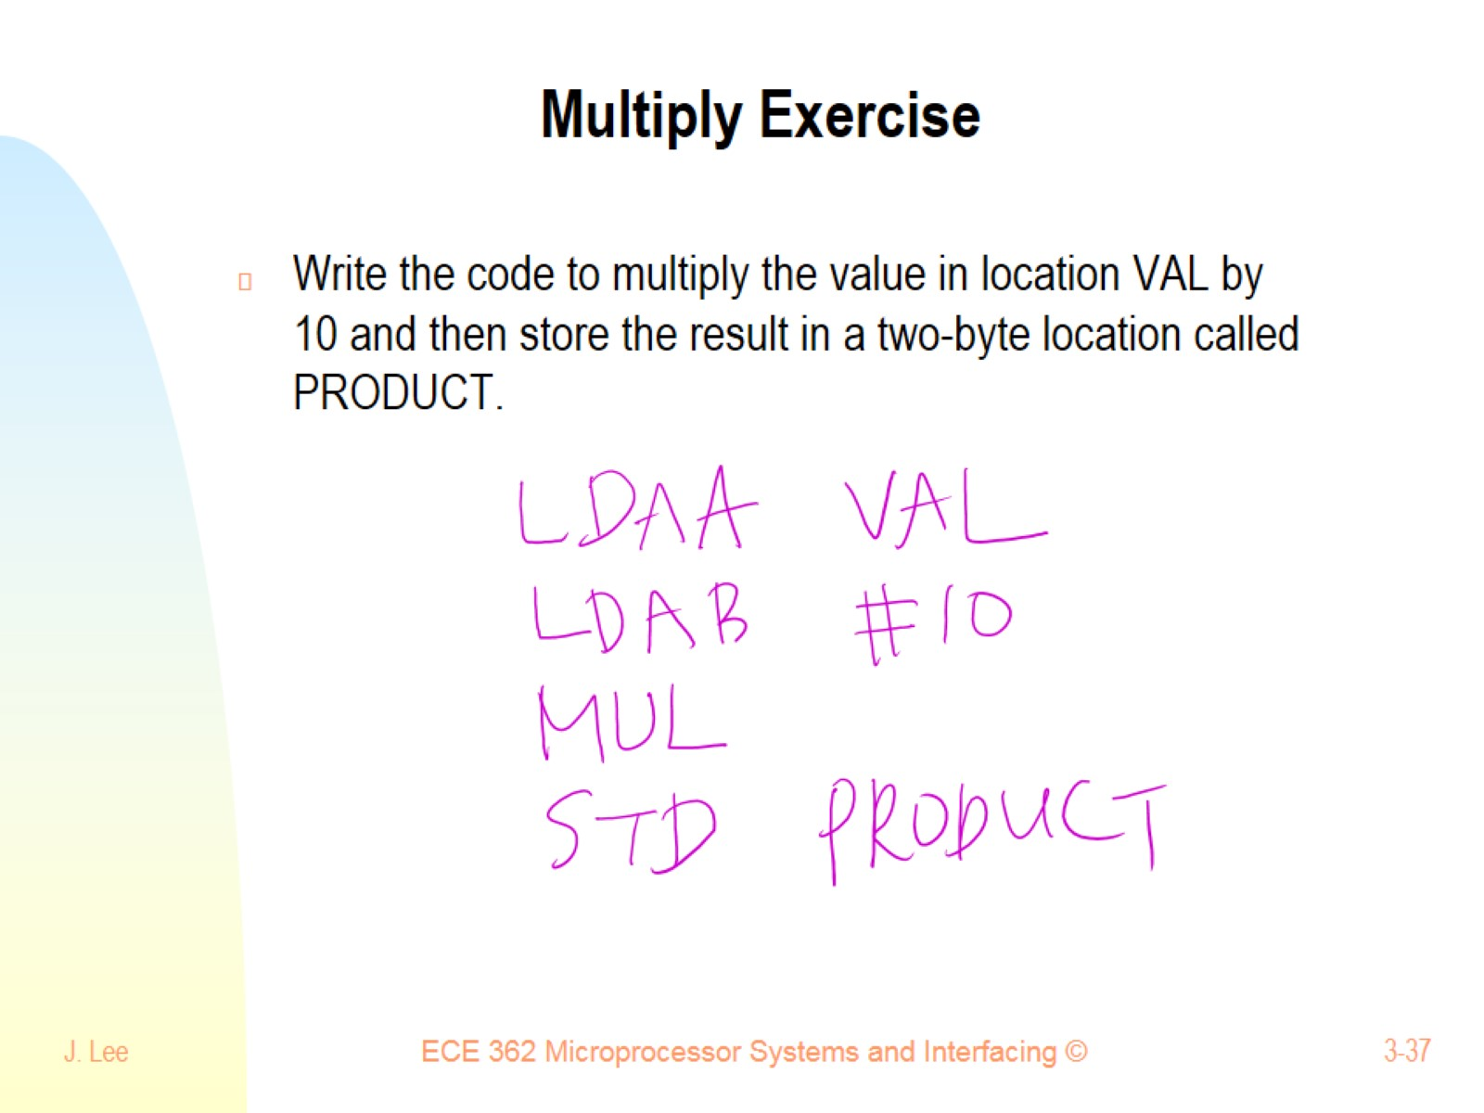
Multiply Exercise

Slide 38
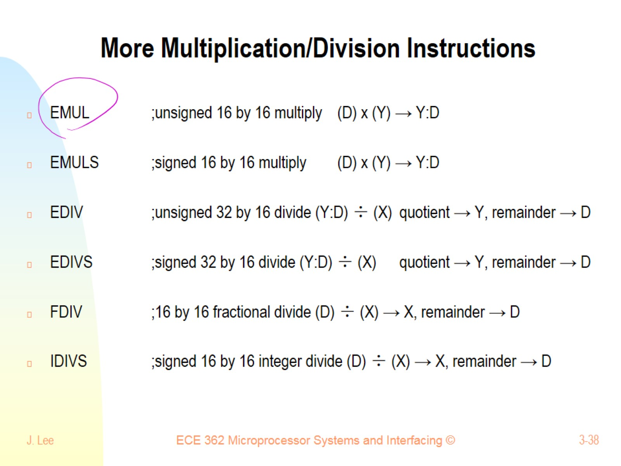
More Multiplication/Division Instructions

Slide 39
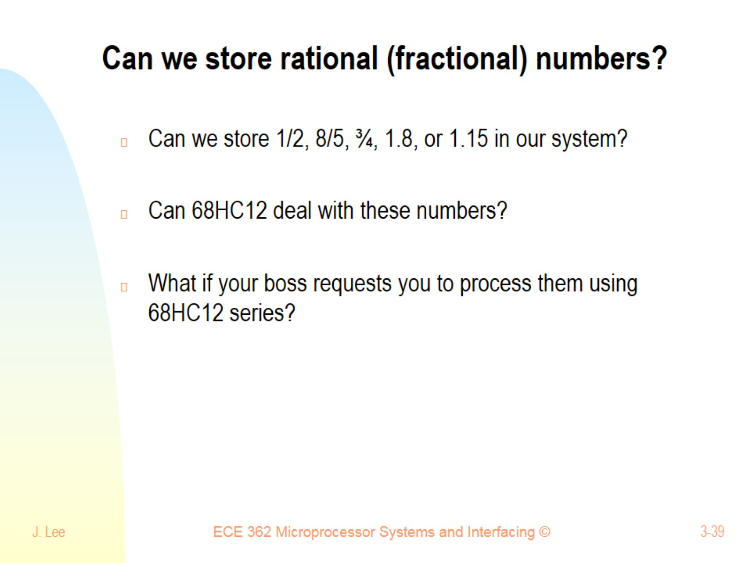
Can we store rational (fractional) numbers?

Slide 40
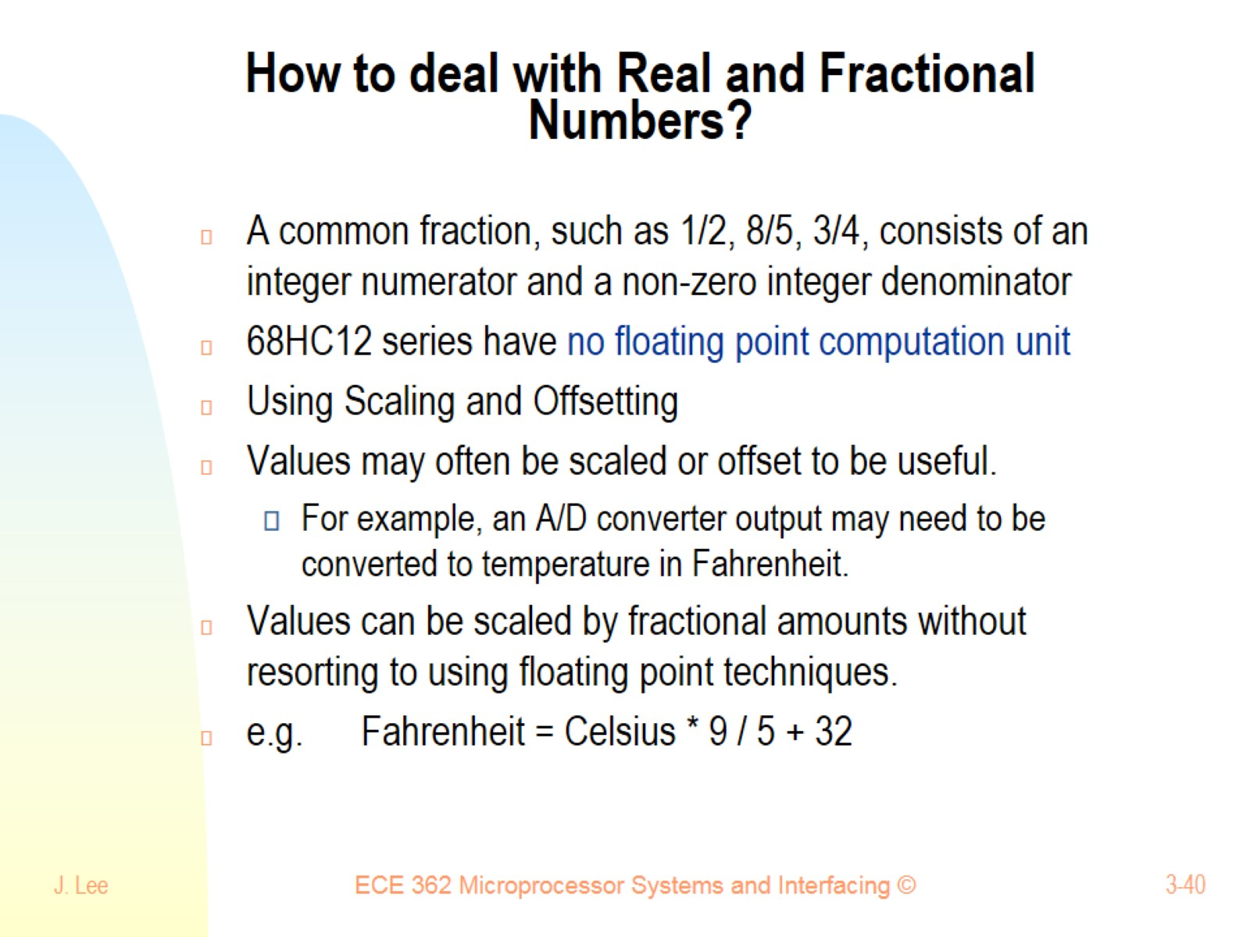
How to deal with Real and Fractional Numbers?

Slide 41
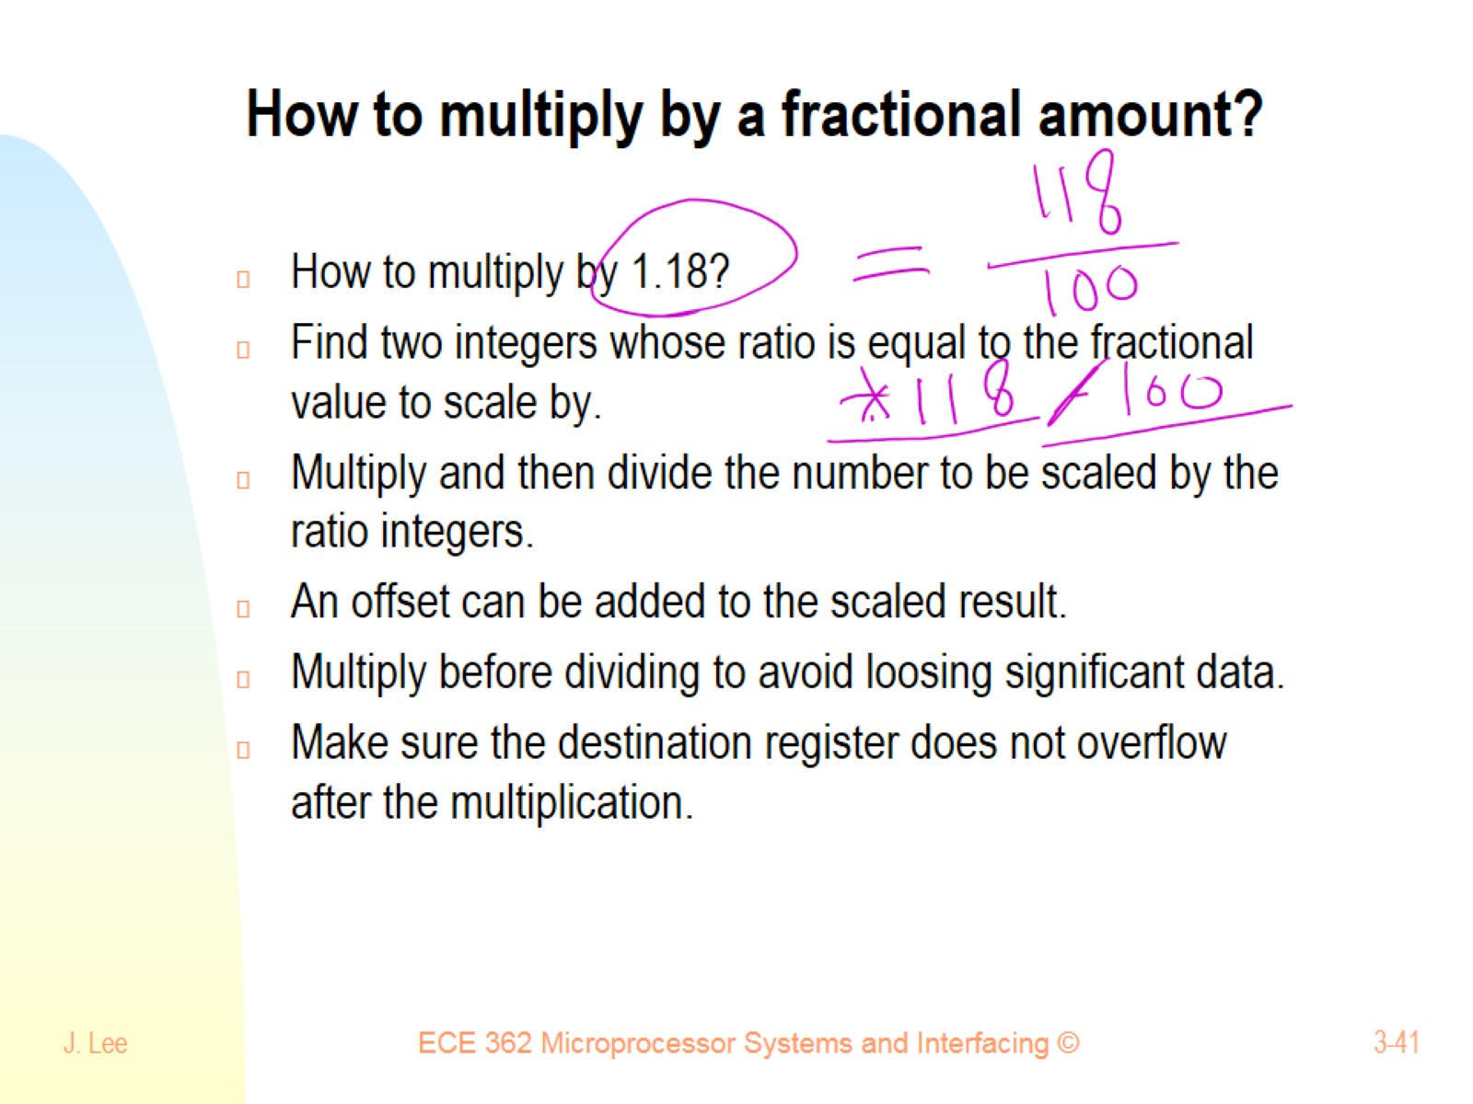
How to multiply by a fractional amount?

Slide 42
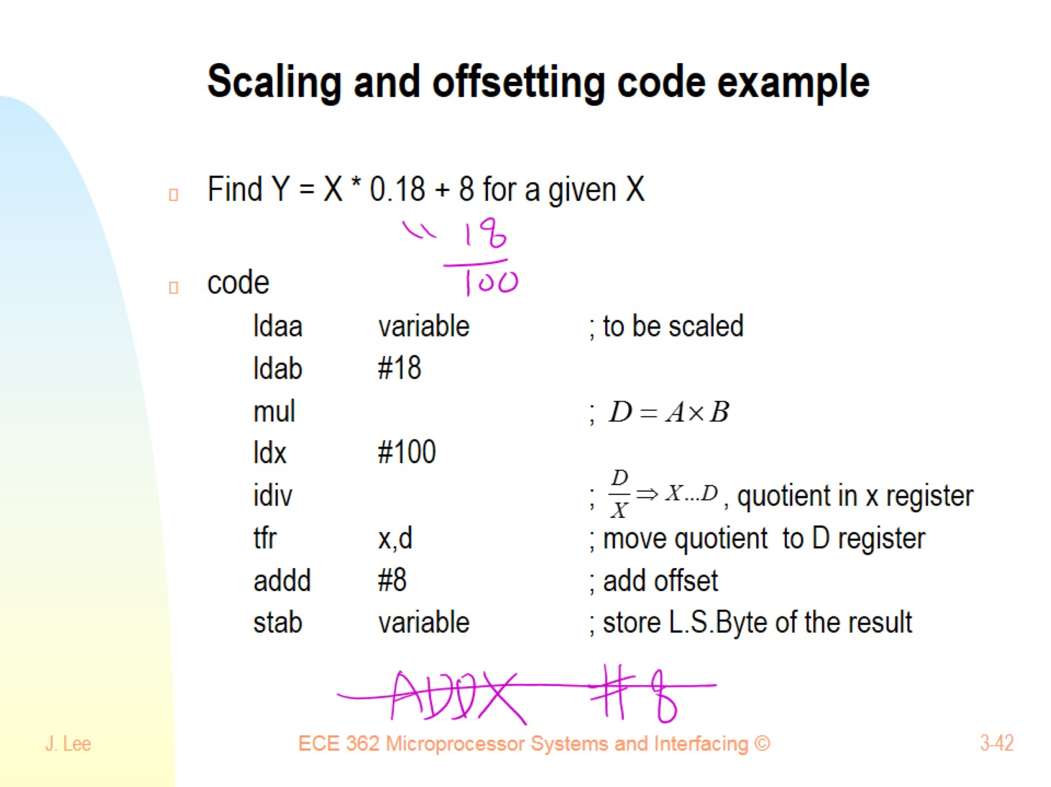
Scaling and offsetting code example

Slide 43
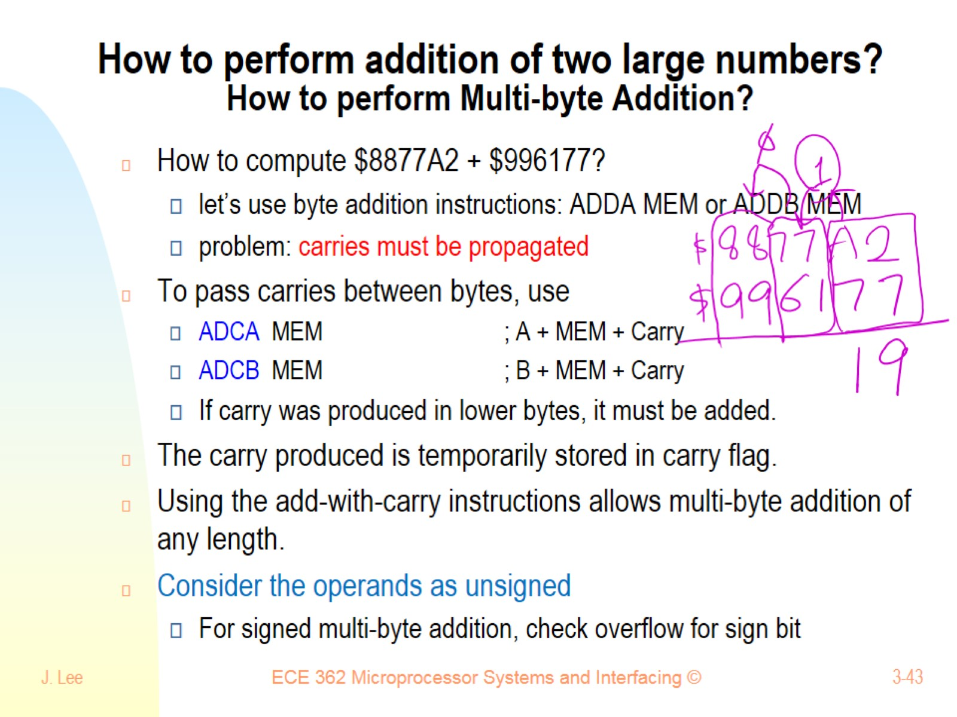
How to perform addition of two large numbers? How to perform Multi-byte Addition?

Slide 44
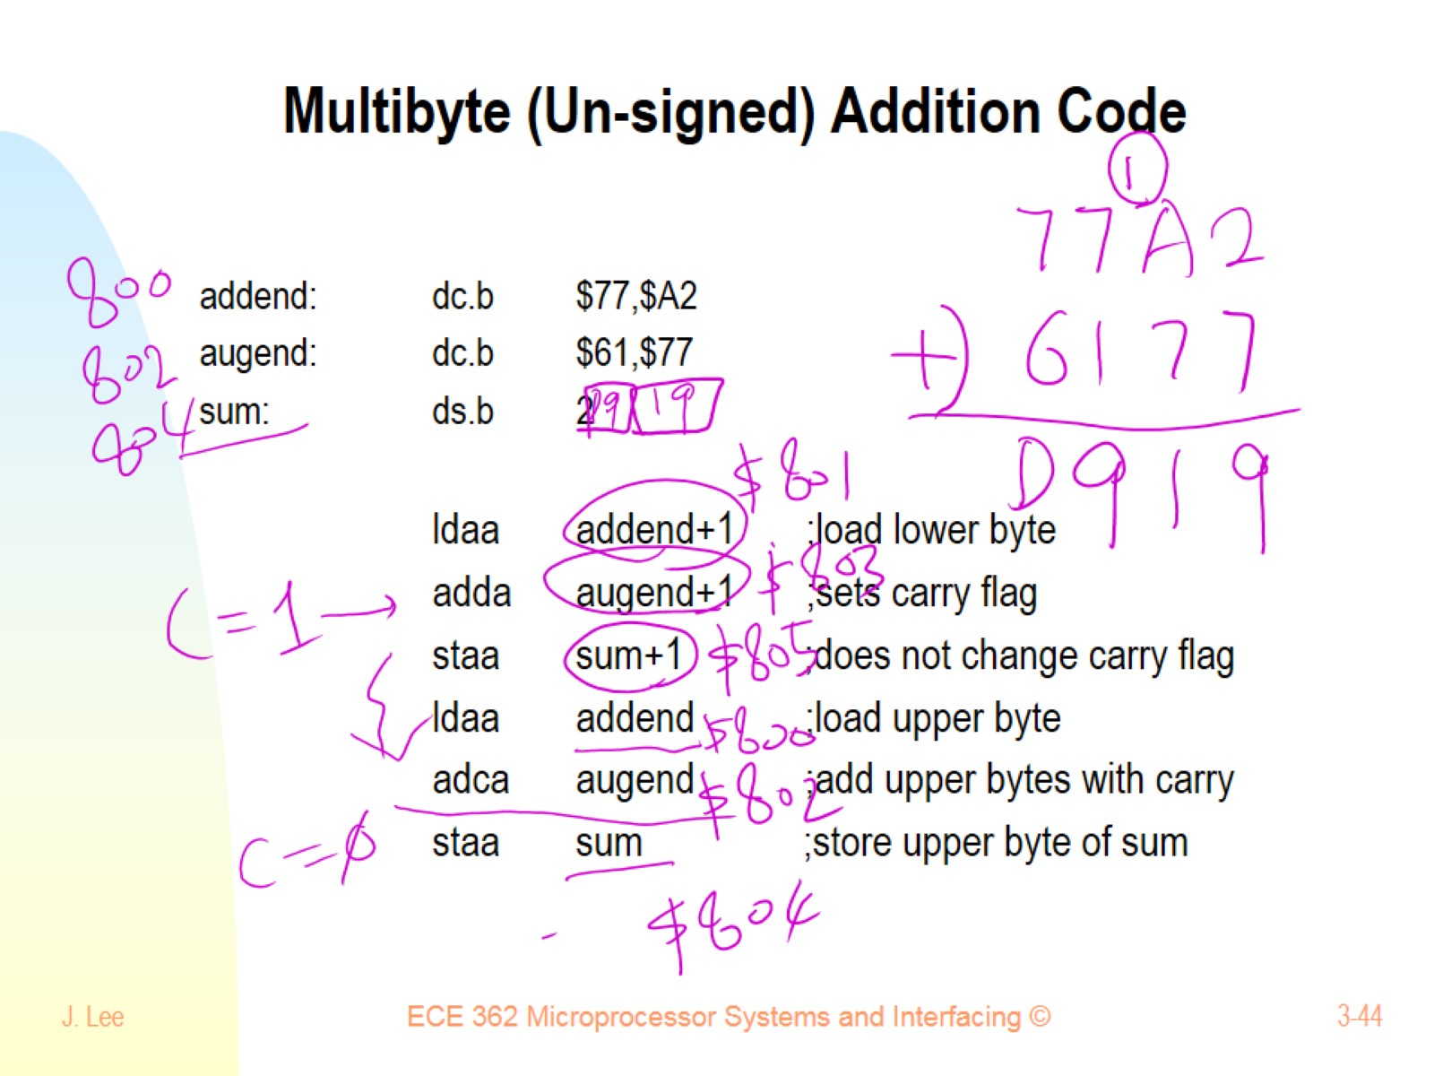
Multibyte (Un-signed) Addition Code

Slide 45
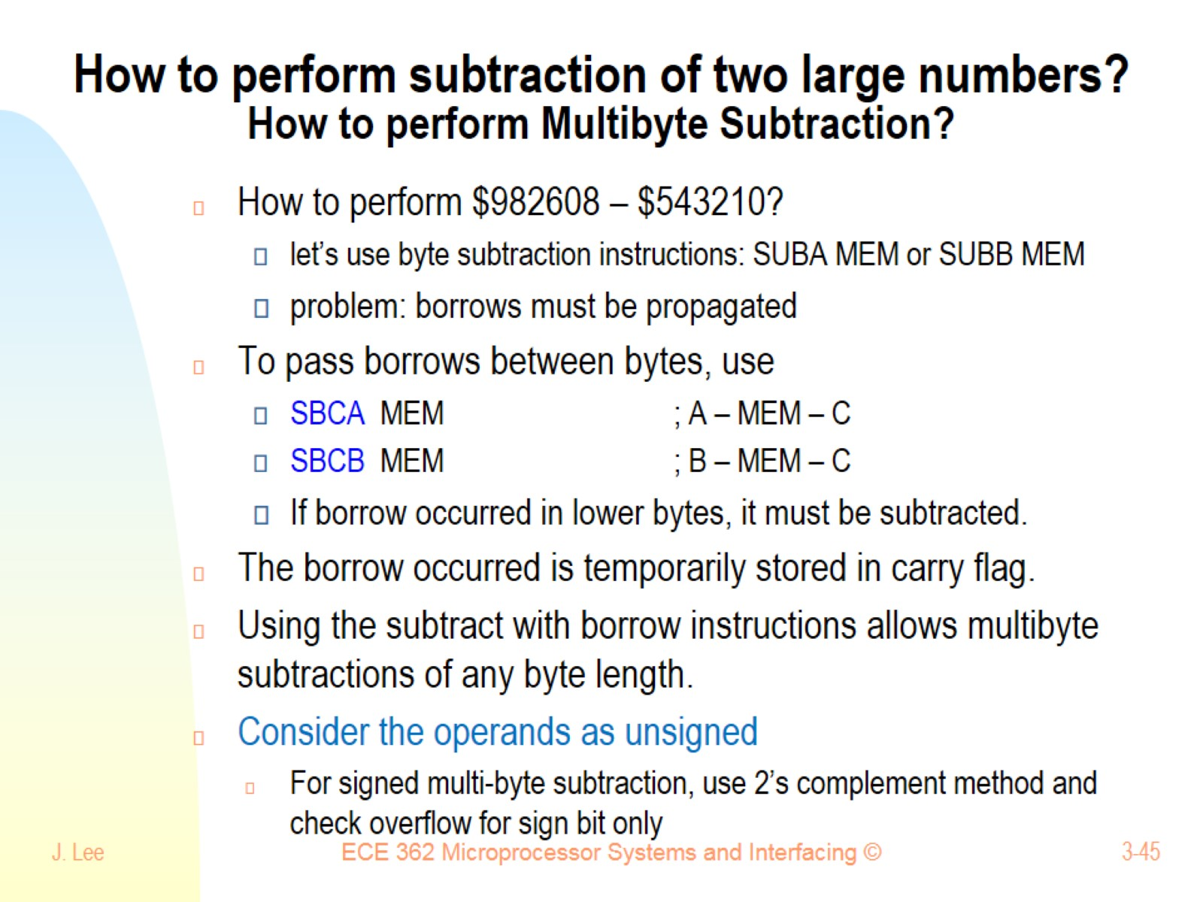
How to perform subtraction of two large numbers? How to perform Multibyte Subtraction?

Slide 46
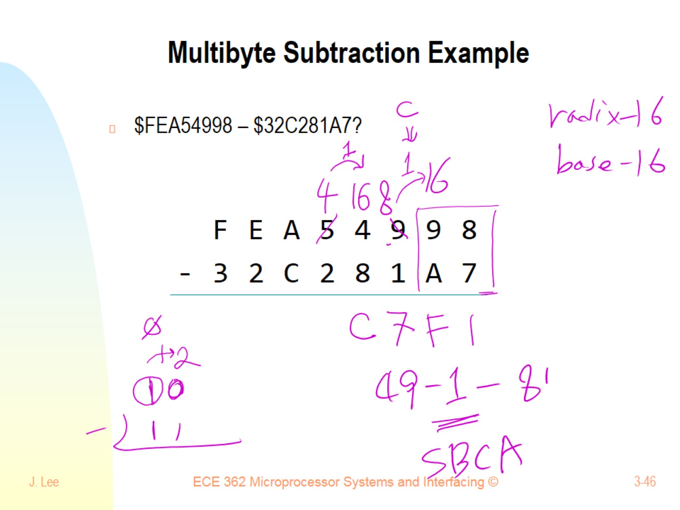
Multibyte Subtraction Example

Slide 47
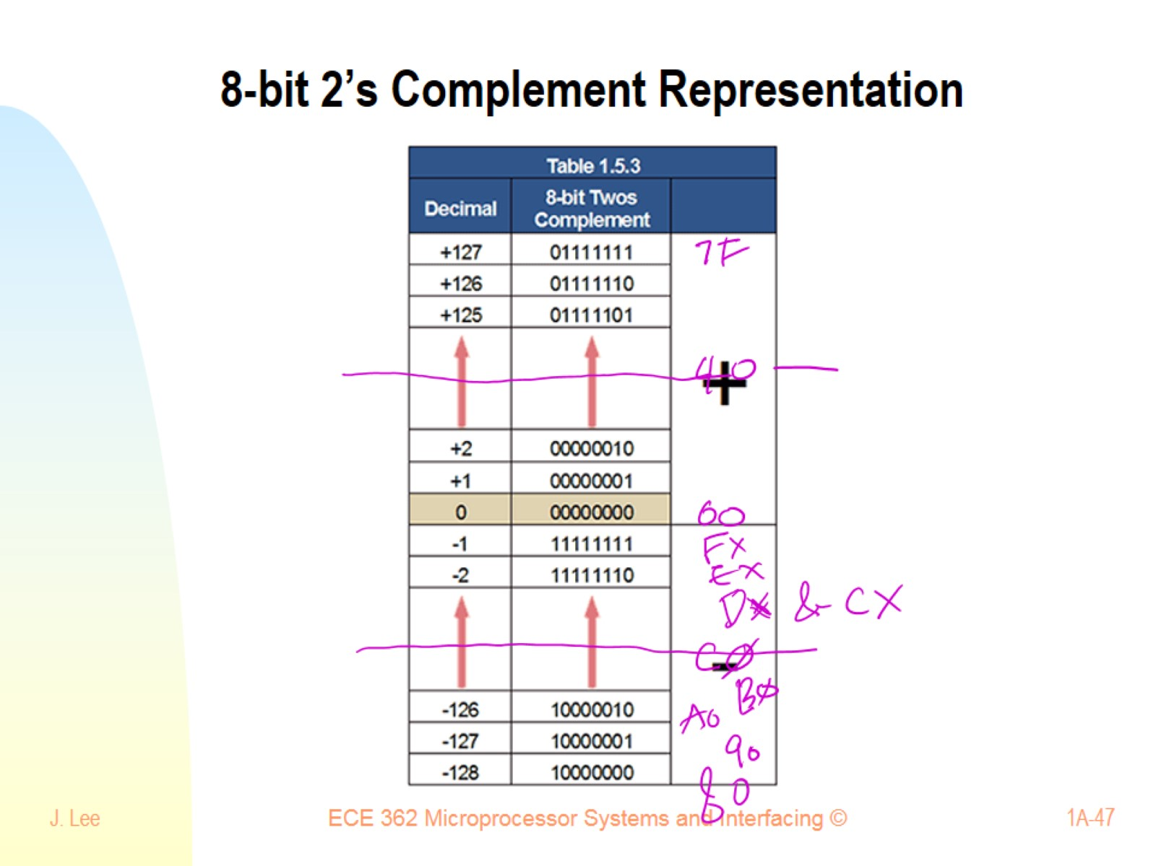
8-bit 2’s Complement Representation

Slide 48
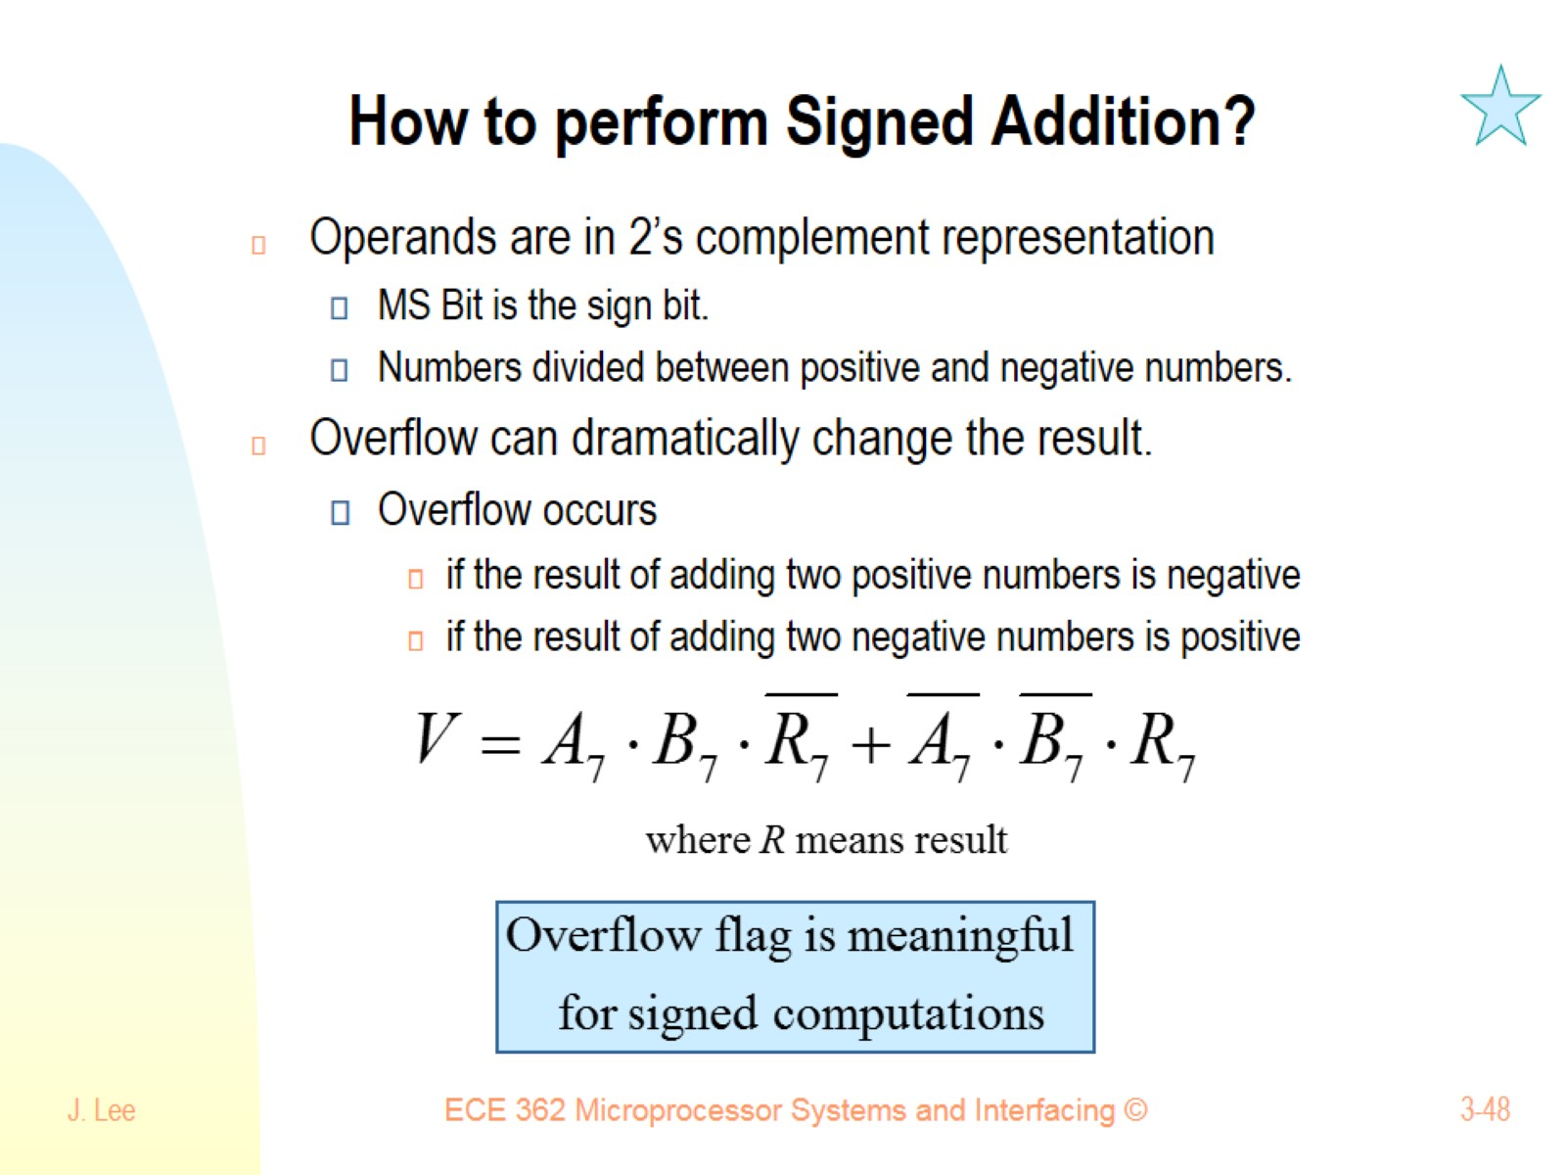
How to perform Signed Addition?

Slide 49
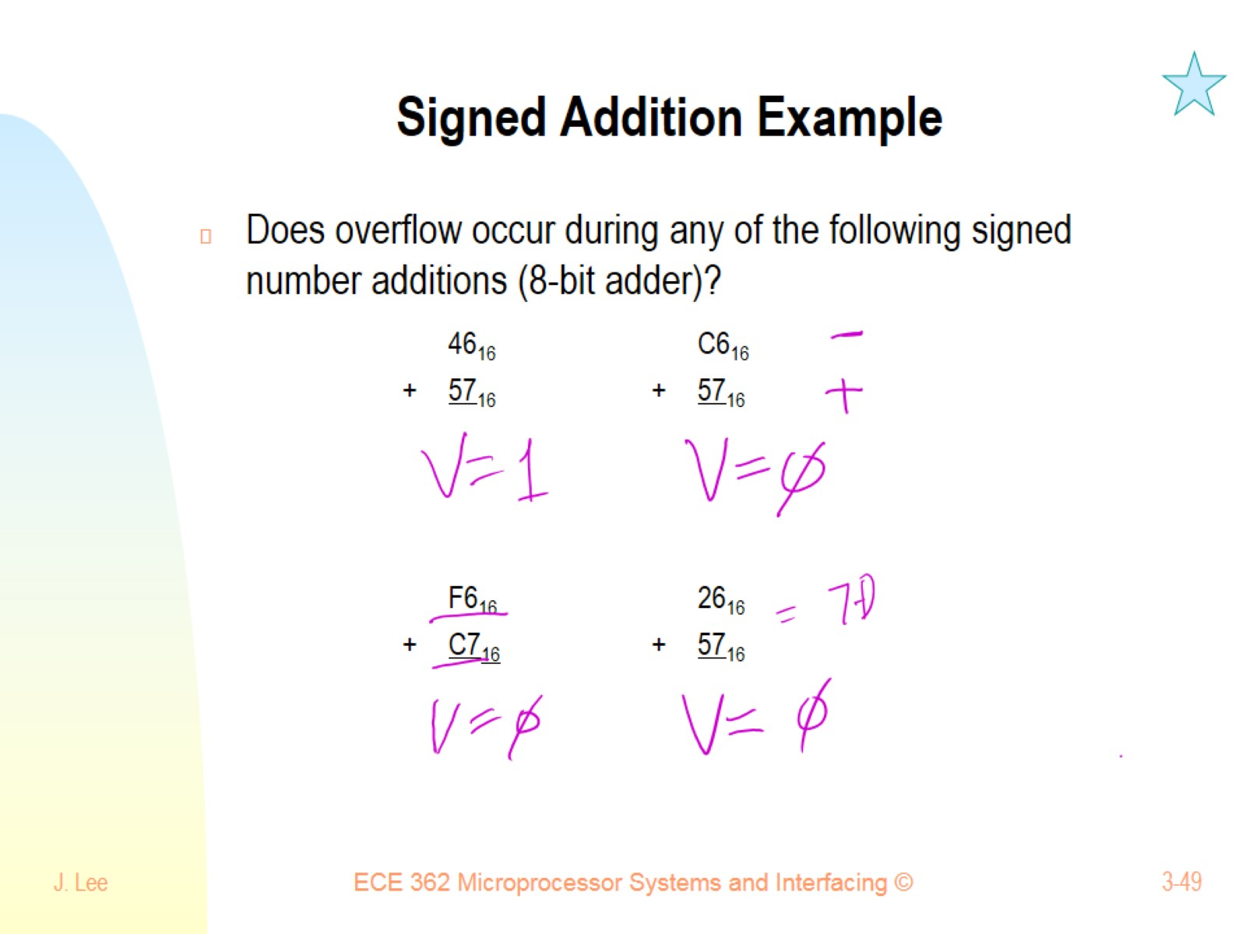
Signed Addition Example

Slide 50
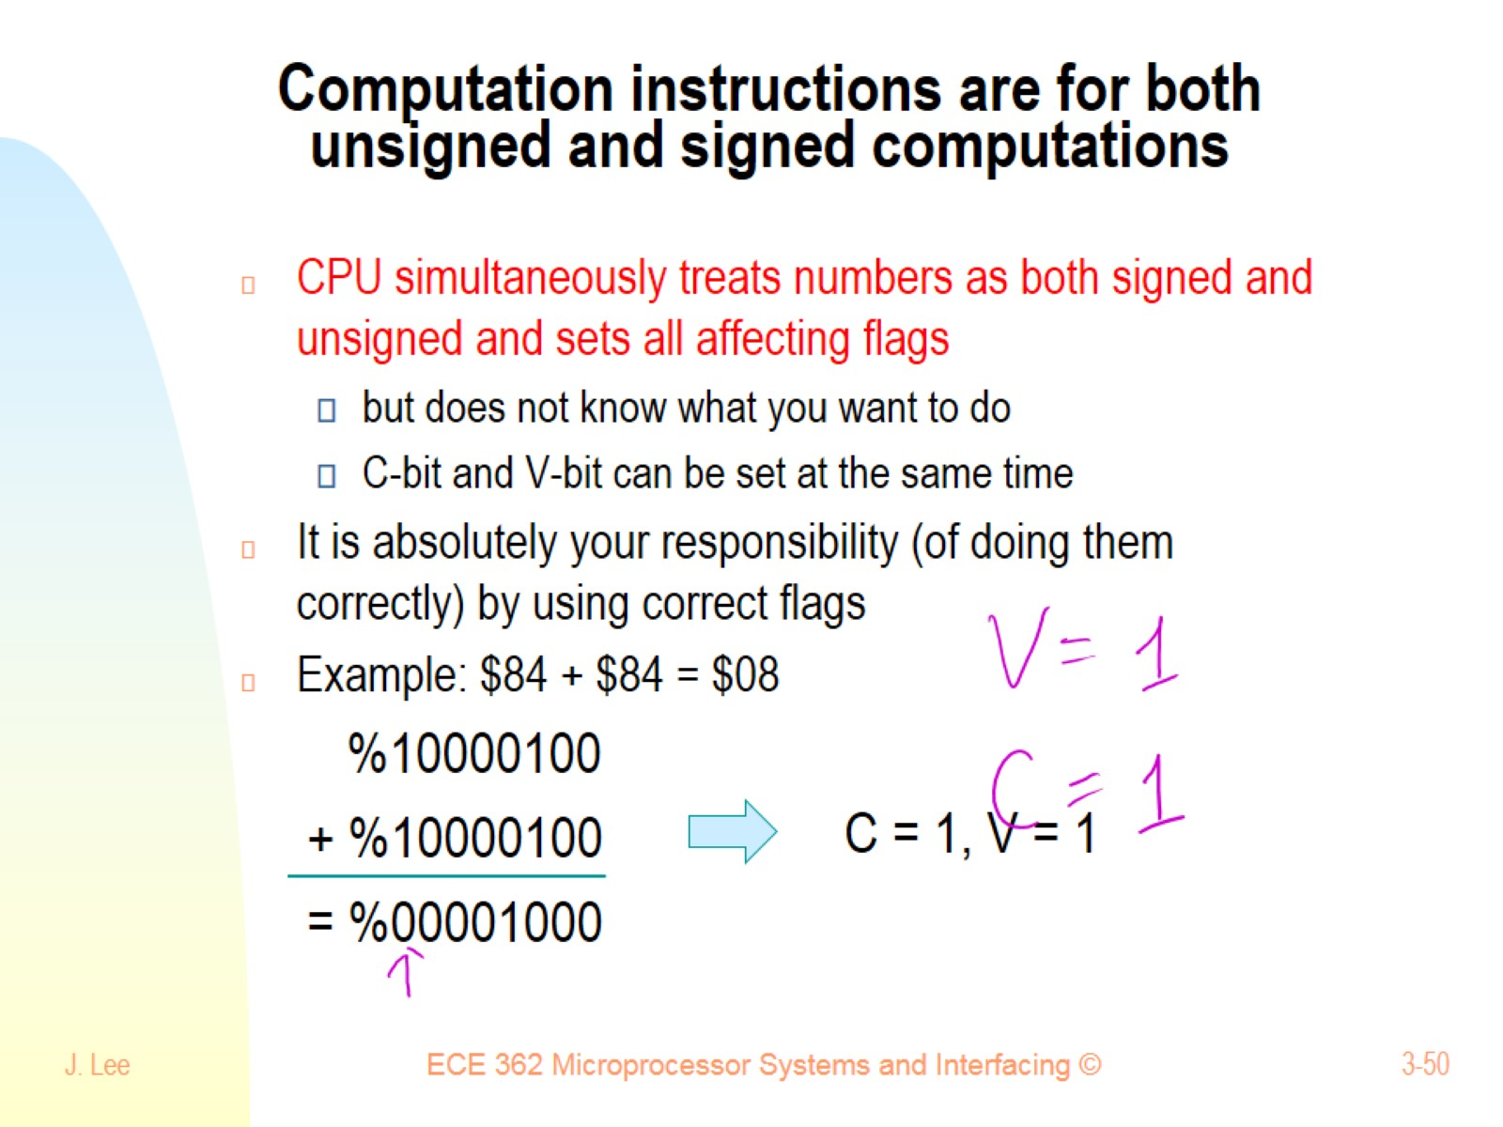
Computation instructions are for both unsigned and signed computations

Slide 51

How to perform Signed Subtraction

Slide 52

How to perform 16-bit or 32-bit signed addition and subtraction?

Slide 53

Summary of Unsigned vs. Signed Computation

